Slide 1
“Those are
Killer Shoes”
EPHESIANS 6

Slide 2
¹⁰ Finally, my brethren, be strong in the Lord, and in the power of his might.
¹¹ Put on the whole armour of God, that ye may be able to stand against the wiles of the devil.
¹² For we wrestle not against flesh and blood, but against principalities, against powers, against the rulers of the darkness of this world, against spiritual wickedness in high places.

Slide 3
¹³ Wherefore take unto you the whole armour of God, that ye may be able to withstand in the evil day, and having done all, to stand.
¹⁴ Stand therefore, having your loins girt about with truth, and having on the breastplate of righteousness;
¹⁵ And your feet shod with the preparation of the gospel of peace;

Slide 4
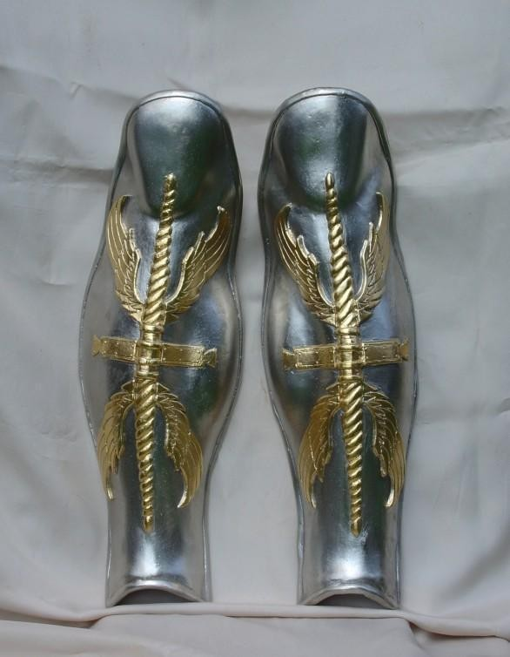
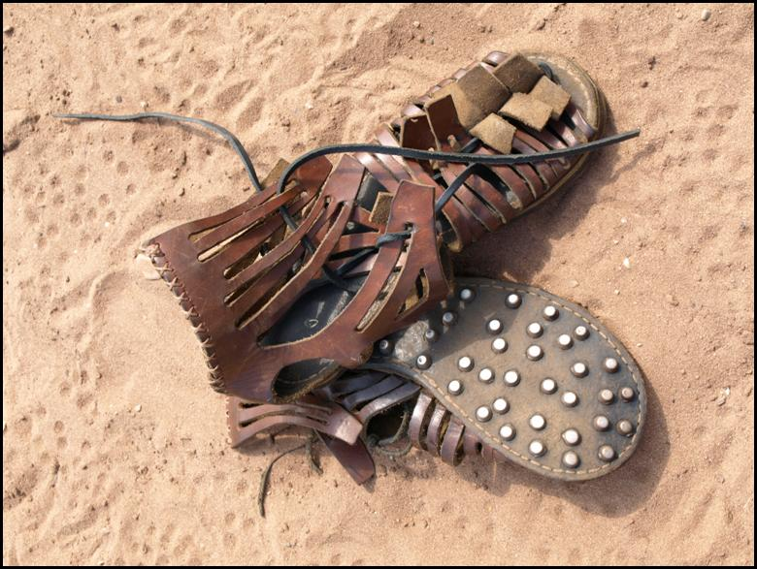
Shoes of Peace

Slide 5
Who Needs Peace?
Eph. 2¹³ But now in Christ Jesus ye who sometimes were far off are made nigh by the blood of Christ.
¹⁴ For he is our peace,

Slide 6
3 Types of Peace the gospel brings
With God
Of God
With Men
Position
Experience
Relationships

Slide 7
Peace With God
Romans 5:1 Therefore being justified by faith, we have peace with God through our Lord Jesus Christ:
Eph 2¹⁶ And that he might reconcile both unto God in one body by the cross, having slain the enmity thereby:

Slide 8
The Feud ended at last at the cross!
What is your position this morning with the King of Kings???

Slide 9
3 Types of Peace the gospel brings
With God
Of God
With Men
Position
Death
Experience
Resurrection
Relationships
His coming

Slide 10
Of God – Experience – Prevailing Peace
Phil 4⁷ And the peace of God, which passeth all understanding, shall keep your hearts and minds through Christ Jesus.
Romans 16²⁰ And the God of peace shall bruise Satan under your feet shortly. The grace of our Lord Jesus Christ be with you. Amen.

Slide 11
Col 3¹⁵ And let the peace of God rule in your hearts,
Isaiah 26³ Thou wilt keep him in perfect peace, whose mind is stayed on thee: because he trusteth in thee. (Focused)
Can you say you have been living with the PEACE OF GOD?

Slide 12
3 Types of Peace the gospel brings
With God
Of God
With Men
Position
Death
Relationships
His Coming
Experience
Resurrection

Slide 13
With Men – “You Belong”
^{Eph 2:14} For he is our peace, who hath made both one, and hath broken down the middle wall of partition between us;
Gal 3²⁸ There is neither Jew nor Greek, there is neither bond nor free, there is neither male nor female: for ye are all one in Christ Jesus.

