Slide 1


Slide 2
Living a Life of Generosity Part - 1
Type
Tithe
Part – 2 “Cheerful Giver”
Able Giver
Love
Part – 3 “It is better to…..”
Trust Contentment
Abounding Life

Slide 3
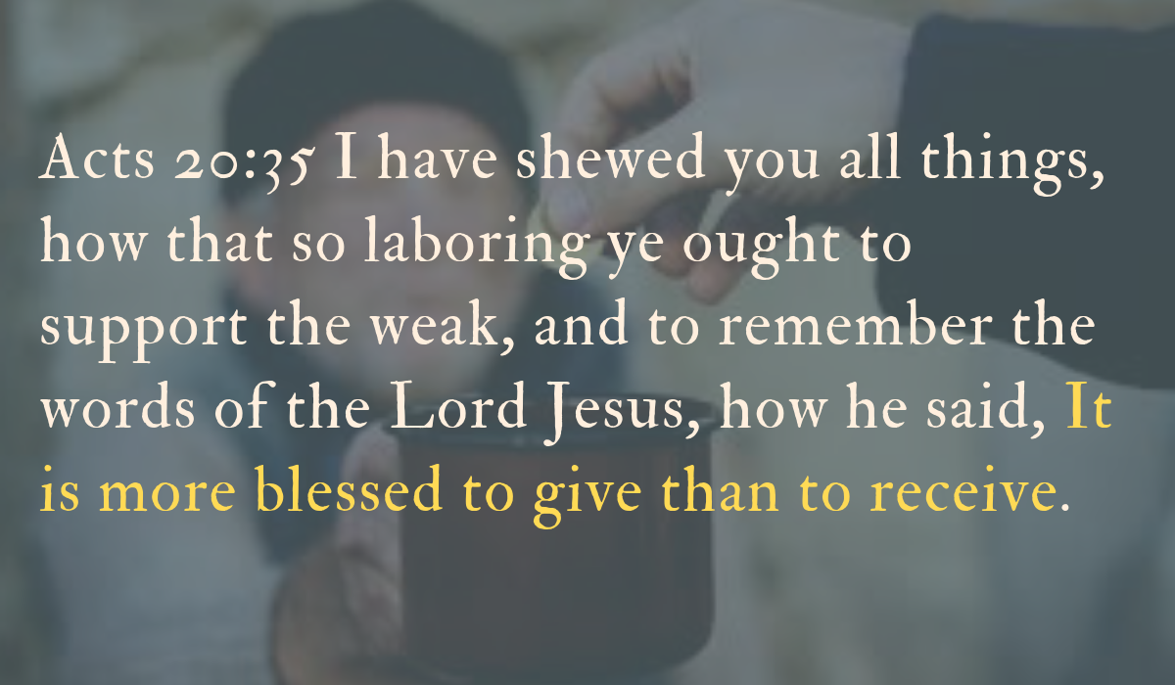

Slide 4
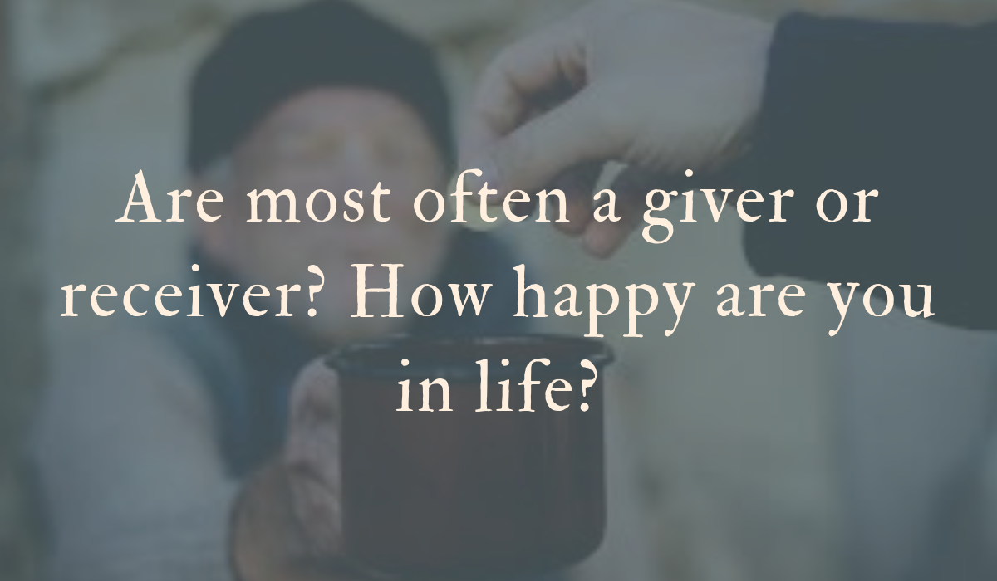

Slide 5
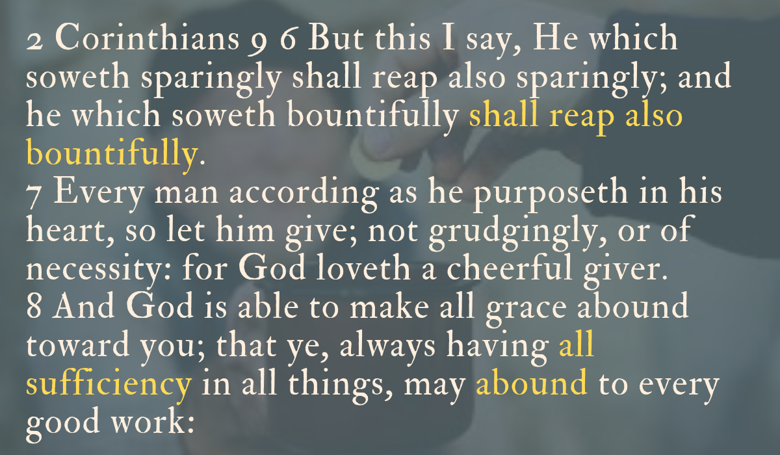

Slide 6
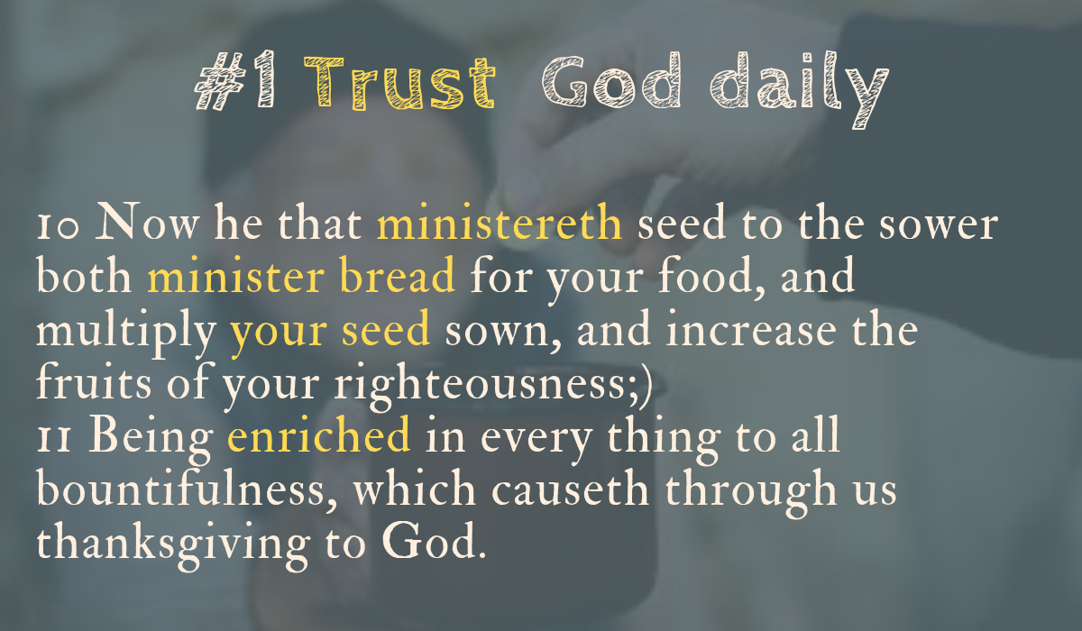

Slide 7


Slide 8
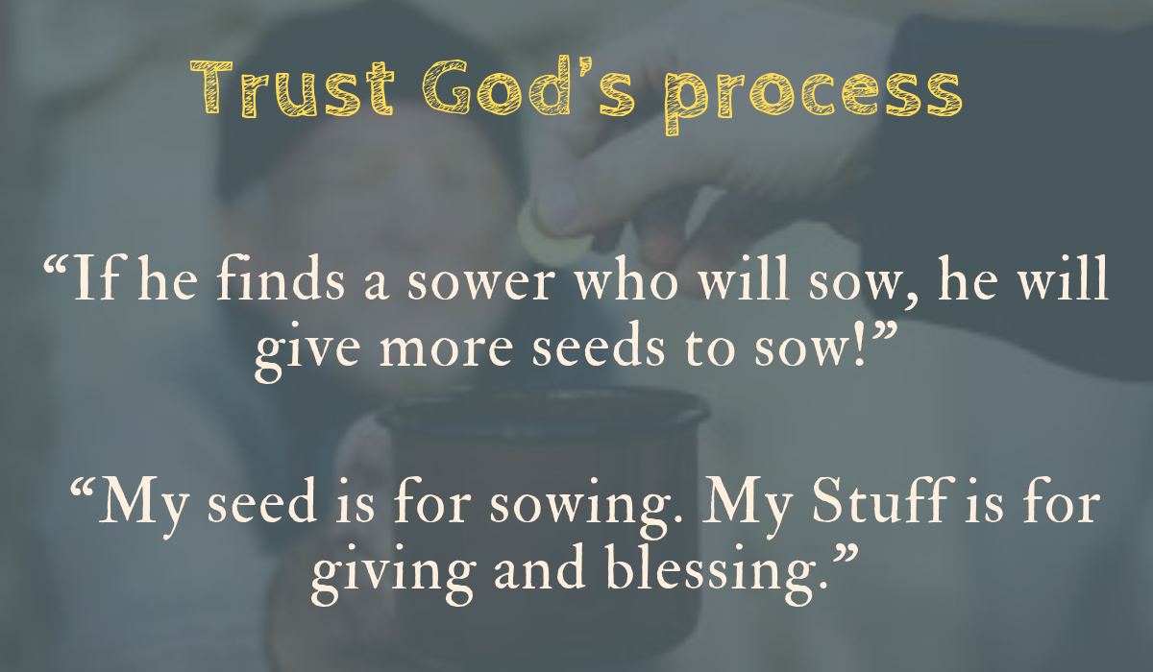

Slide 9
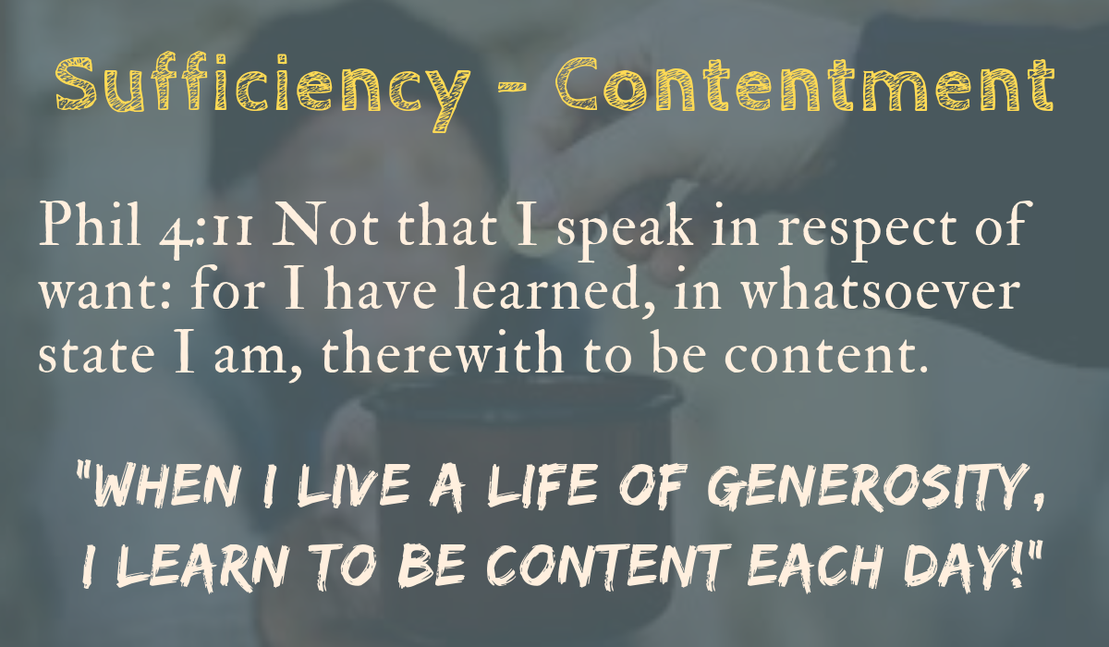

Slide 10
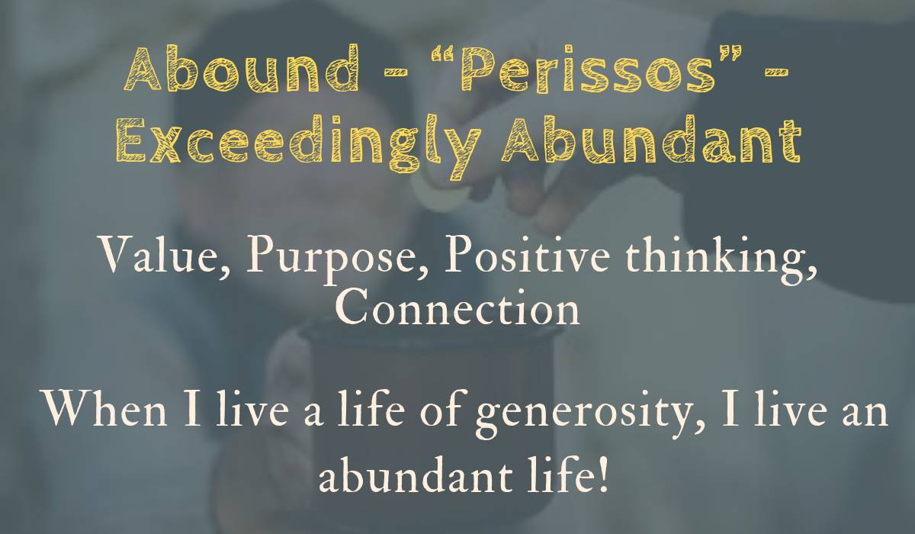

Slide 11


Slide 12
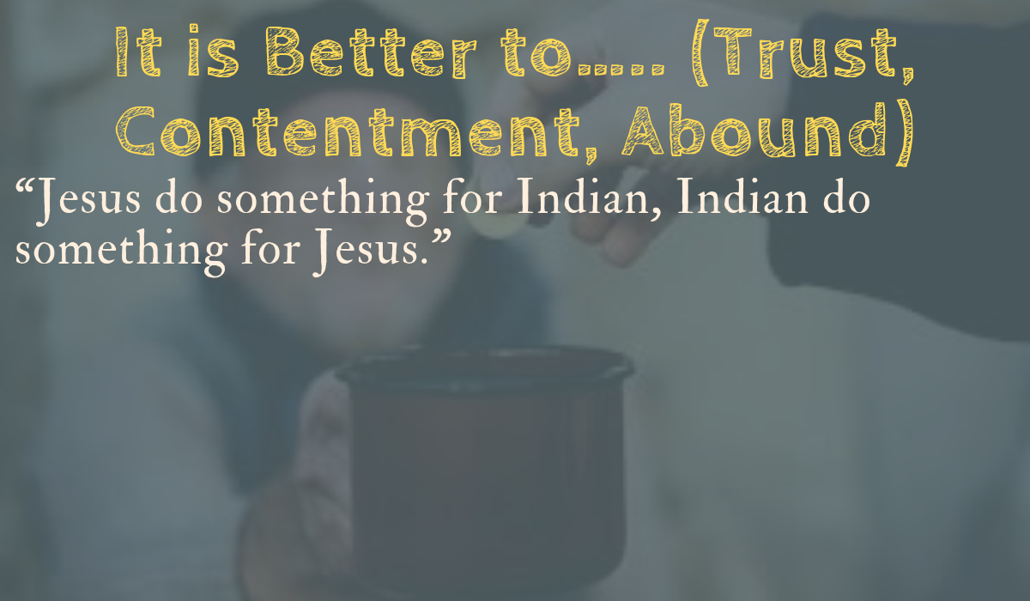

Slide 13
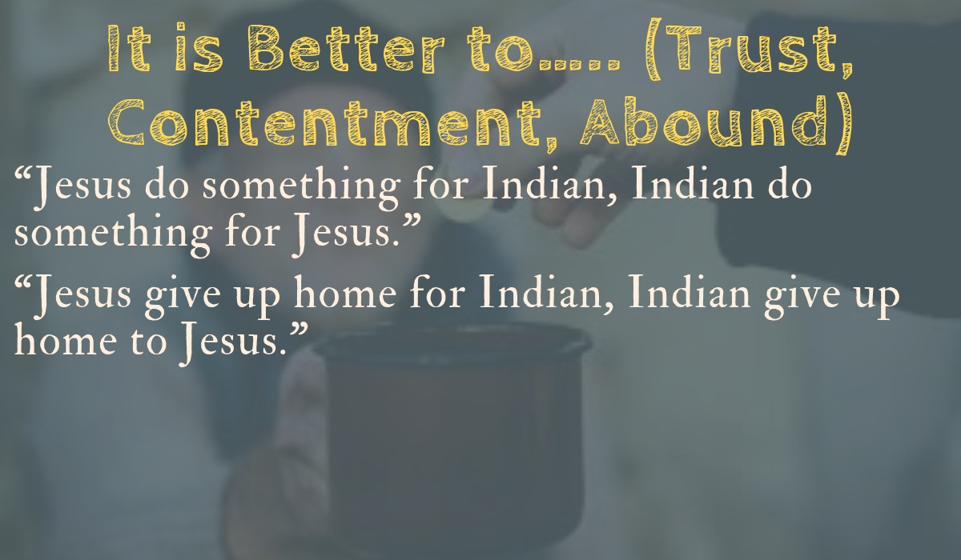

Slide 14
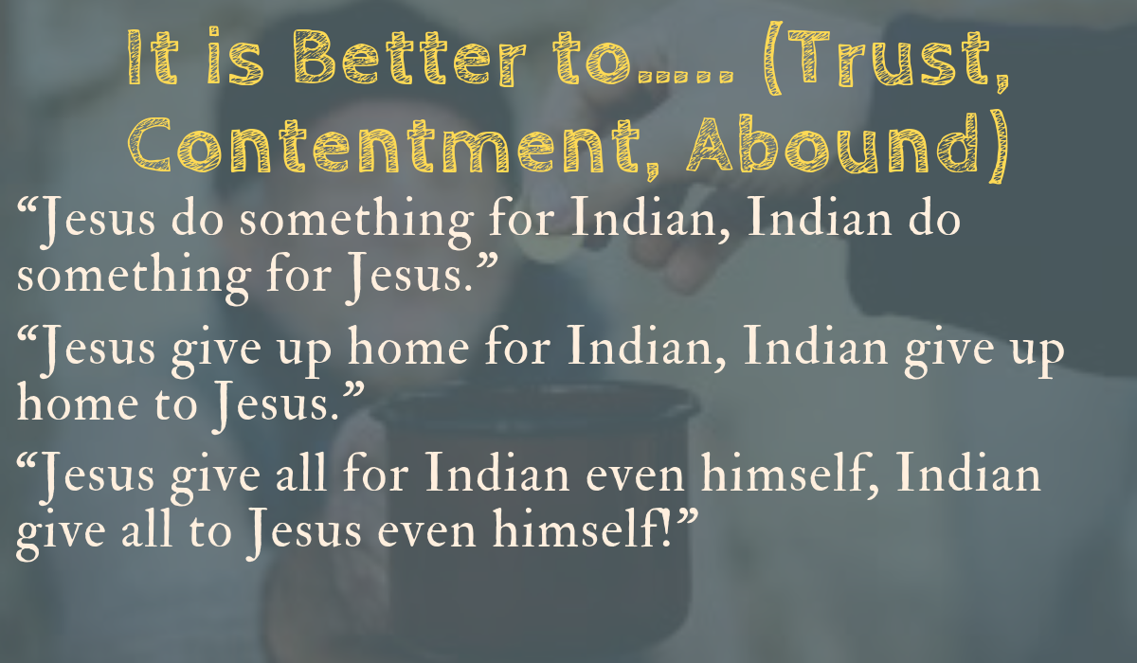

Slide 15
