Slide 1
God’s Answer for Suffering Part 1
Luke 23:34

Slide 2
The Cross teaches us that not only can Jesus teach us the why and how of suffering, but that we have a God who has suffered!

Slide 3
Luke 23:34 Then said Jesus, Father forgive them: for they know not what they do. And they parted his raiment, and cast lots.

Slide 4
Who are They?
They Do
Know not
Romans 5⁶ For when we were yet without strength, in due time Christ died for the ungodly.

Slide 5
They
“Before we can begin to see the cross as something done for us, we have to see it as something done by us.” – John Stott

Slide 6
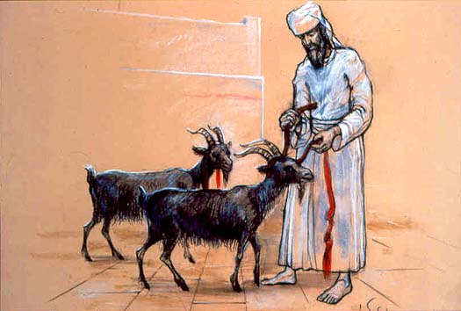
Who is He?
Pleads in Suffering
Pleads as a Son
Pleads as a Sacrifice
“Forgive”

Slide 7
“The Pathway in dealing with our own suffering begins with forgiveness!”
“I can be forgiven!”

Slide 8
For Us
Matthew 18³⁵ So likewise shall my heavenly Father do also unto you, if ye from your hearts forgive not every one his brother their trespasses.
“If we have become truly the children of God, then if God has forgiven us, we are to forgive!”

Slide 9
What about us?
Matthew 6¹⁴ For if ye forgive men their trespasses, your heavenly Father will also forgive you:
¹⁵ But if ye forgive not men their trespasses, neither will your Father forgive your trespasses.
“You cannot get forgiveness from God, without also forgiving others. If you refuse to do your part, you cut yourself off from God’s part!”

Slide 10
Ephesians 4³² And be ye kind one to another, tenderhearted, forgiving one another, even as God for Christ's sake hath forgiven you.

