Slide 1
God’s Answer to Suffering Part 3
John 19: 26 - 27

Slide 2
What is God to do with my suffering?
“A sickbed often teaches more than a sermon” – Thomas Watson
“Smooth seas do not make skillful Sailors!” – African Proverb

Slide 3
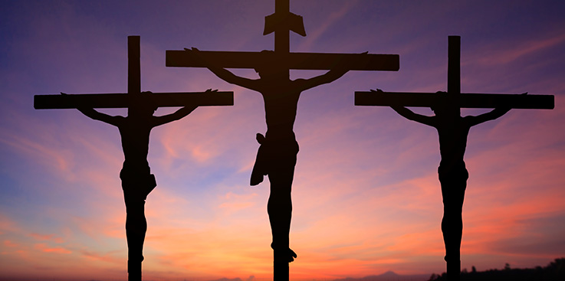
What is God’s Answer to our suffering?
We have a God that not only knows and explains suffering, but we have a God who has suffered!

Slide 4
^{John 19:25} Now there stood by the cross of Jesus his mother, and his mother's sister, Mary the wife of Cleophas, and Mary Magdalene.
²⁶ When Jesus therefore saw his mother, and the disciple standing by, whom he loved, he saith unto his mother, Woman, behold thy son!
²⁷ Then saith he to the disciple, Behold thy mother! And from that hour that disciple took her unto his own home.

Slide 5
Learn to Serve in Suffering
Joseph lived his life to serve the life of others!
Gods Favor
“If Joseph would have never been Egypt’s prisoner, he would have never been Egypt’s governor! The Iron chains about his feet ushered in Golden chains about his neck!”

Slide 6
Learn to Serve in Suffering
Jesus our Example
Jesus with the bread
Jesus with the towel
Jesus with his mother!
“God help me to learn to Serve in my Suffering!”

Slide 7
Learn to Lean on my Tribes
“People Need People!”
“Everybody needs a circle, You need a tribe.”
“Call it a clan, call it a network, call it a tribe, call it a family; whatever you call it, whoever you are, you need one!” – Jane Howard

Slide 8
Learn to Lean on Tribes
Jesus shows the priority of two main tribes: Family and Church!
“We need Family and We need Church!”
“Friendships made at the foot of the Cross are the truest and best where death will never destroy them!”

Slide 9
Learn to Find Comfort in our Suffering
They had the courage to come to the cross!
Do you love him in all seasons?
They found comfort at the cross!

