Slide 1
Gods Answer to Suffering
Part 2
Luke 23

Slide 2
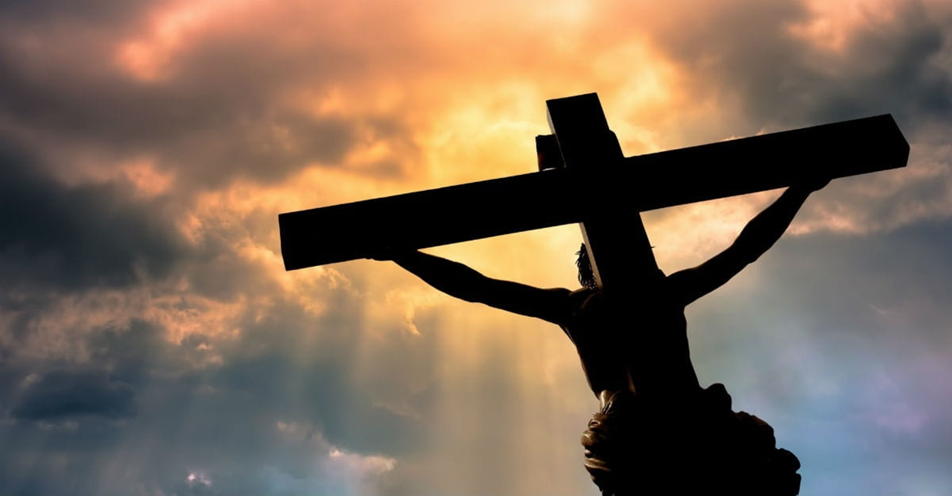
We have a God that has Suffered!

Slide 3
^{Luke 23: 35} And the people stood beholding. And the rulers also with them derided him, saying, He saved others; let him save himself, if he be Christ, the chosen of God.
³⁶ And the soldiers also mocked him, coming to him, and offering him vinegar,
³⁷ And saying, If thou be the king of the Jews, save thyself.

Slide 4
³⁹ And one of the malefactors which were hanged railed on him, saying, If thou be Christ, save thyself and us.
⁴⁰ But the other answering rebuked him, saying, Dost not thou fear God, seeing thou art in the same condemnation?
⁴¹ And we indeed justly; for we receive the due reward of our deeds: but this man hath done nothing amiss.

Slide 5
⁴² And he said unto Jesus, Lord, remember me when thou comest into thy kingdom.
⁴³ And Jesus said unto him, Verily I say unto thee, Today shalt thou be with me in paradise.

Slide 6
Which Side of the Cross are you on?
Jesus with the criminals –
“All Men are criminals against God.”
“God will hold no sin against any man if that man will personally trust in his son!”
“He was unwilling to save himself, because in not saving himself he was saving others!”

Slide 7
Which Side of the Cross are you on? Left
Pride in self
Unrepentant
“Unconfessed sin is unforgiven sin, and unforgiven sin is the darkest, foulest thing on this sin-cursed earth.” – D.L. Moody
No Fear of God

Slide 8
Which Side of the Cross are you on? Right
Suffering tends to bring clarity to our perspective and show us reality and eternity.
“God whispers to us in our pleasures, speaks in our conscience, but shouts in our pain: it is His megaphone to rouse a deaf world.” – C.S. Lewis

Slide 9
Which Side of the Cross are you on? Right
1. Fear of God (Conviction)
2. Repentance (Confession)
3. Profession of Christ (Sinless, Lord, Resurrection, and Forgiveness)
“The Thief stands to accuse those who have heard of the gospel from a young age!”

Slide 10
Which Side of Suffering are you on?
Left: “Why are you not here, Where are you, If you are God…..”
Right: “Remember me, be mindful of me, in this suffering I want to be with you!”

Slide 11
Which Side of Eternity are you on?
⁴³ And Jesus said unto him, Verily I say unto thee, Today shalt thou be with me in paradise.
Romans 8¹⁸ For I reckon that the sufferings of this present time are not worthy to be compared with the glory which shall be revealed in us.

Slide 12
“Heaven and Taking others to Heaven”
2 Corinthians 4¹⁷ For our light affliction, which is but for a moment, worketh for us a far more exceeding and eternal weight of glory;
¹⁸ While we look not at the things which are seen, but at the things which are not seen: for the things which are seen are temporal; but the things which are not seen are eternal.

