Slide 1
Church of Pergamos
Worldly Church

Slide 2
Review - From chapter 1: 17 – 18 What is the theme of this book?
¹⁷ And when I saw him, I fell at his feet as dead. And he laid his right hand upon me, saying unto me, Fear not; I am the first and the last:
¹⁸ I am he that liveth, and was dead; and, behold, I am alive for evermore, Amen; and have the keys of hell and of death.
Do not fear because Jesus is still alive and well with all power!

Slide 3
Review: What is the Outline of the book?
Chp. 1:19
V 19 – Write the things which thou hast seen, and the things which are, and the things which shall be hereafter.
The things you have seen (chp 1), things that are (chp 2-3), things which shall be hereafter.
In our Study now, where on the outline are we?

Slide 4
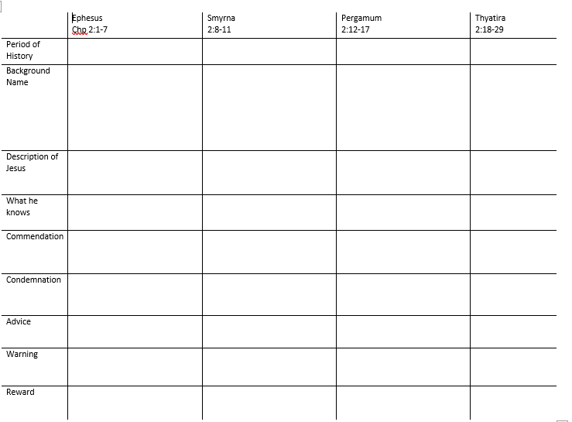

Slide 5
Review: Smyrna – How did Jesus introduce himself (description) and what did that mean?
⁸ And unto the angel of the church in Smyrna write; These things saith the first and the last, which was dead, and is alive;
It Ain’t Over

Slide 6
Review – Smyrna- Jesus said he Knows: what three things did Jesus know they were facing?
⁹ I know thy works, and tribulation, and poverty, (but thou art rich) and I know the blasphemy of them which say they are Jews, and are not, but are the synagogue of Satan.
¹⁰ Fear none of those things which thou shalt suffer: behold, the devil shall cast some of you into prison, that ye may be tried; and ye shall have tribulation ten days: be thou faithful unto death, and I will give thee a crown of life. (Persecution)
Poverty, Slander (Blaspheme of the Jews), Persecution

Slide 7
Review: What compliment or commendation did Jesus give them?
⁹ I know thy works, and tribulation, and poverty, (but thou art rich) and I know the blasphemy of them which say they are Jews, and are not, but are the synagogue of Satan.
You are rich

Slide 8
Review: What counsel or advice did Jesus give them?
¹⁰ Fear none of those things which thou shalt suffer: behold, the devil shall cast some of you into prison, that ye may be tried; and ye shall have tribulation ten days: be thou faithful unto death, and I will give thee a crown of life.
Don’t be afraid and Be Faithful.

Slide 9
Review: What 2 things did he promise?
¹⁰ Fear none of those things which thou shalt suffer: behold, the devil shall cast some of you into prison, that ye may be tried; and ye shall have tribulation ten days: be thou faithful unto death, and I will give thee a crown of life.
¹¹ He that hath an ear, let him hear what the Spirit saith unto the churches; He that overcometh shall not be hurt of the second death.
Crown of life and no second death.

Slide 10
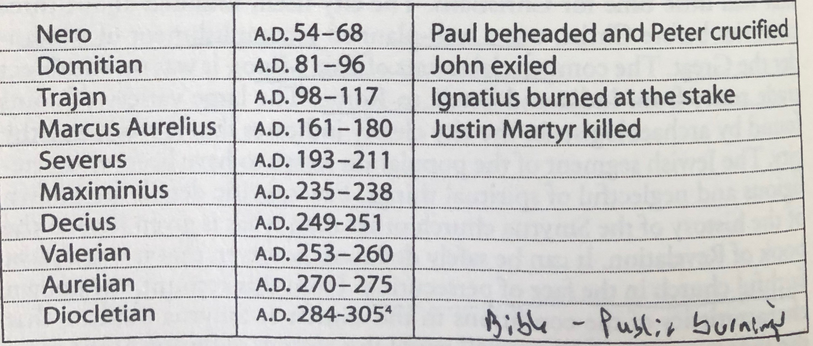
10 Days of Persecution - Historical

Slide 11
Time Line prophetic of the History of the churches
Pentecost
100 A.D
316 A.D
Ephesus
Smyrna

Slide 12
¹² And to the angel of the church in Pergamos write; These things saith he which hath the sharp sword with two edges;
Background:
Description of Jesus

Slide 13
¹³ I know thy works, and where thou dwellest, even where Satan's seat is: and thou holdest fast my name, and hast not denied my faith, even in those days wherein Antipas was my faithful martyr, who was slain among you, where Satan dwelleth.
What he Knows:
Commendation:
Hold fast my name
Have not denied the faith

Slide 14
¹⁴ But I have a few things against thee, because thou hast there them that hold the doctrine of Balaam, who taught Balac to cast a stumblingblock before the children of Israel, to eat things sacrificed unto idols, and to commit fornication.
¹⁵ So hast thou also them that hold the doctrine of the Nicolaitanes, which thing I hate.
Condemnation:
Doctrine of Balaam – Numbers 22 – (Worldliness)
Doctrine of the Nicolaitanes (Christian Liberty and Priesthood).

Slide 15
Becoming the State Church- Prophetic
300 A.D. | Prayers for the dead
300 A.D. | Making a sign of the cross
375 A.D. 380 A.D. | Worship of saints and Angels Edict of Thessalonica
394 | Mass instituted
431 | Worship of Mary
500 | Priests dressed differently than lay people
593 | Purgatory

Slide 16
¹⁶ Repent; or else I will come unto thee quickly, and will fight against them with the sword of my mouth.
Counsel (Advice):
Repent
Warning
My Sword

Slide 17
Hebrews 4 ¹² For the word of God is quick, and powerful, and sharper than any twoedged sword, piercing even to the dividing asunder of soul and spirit, and of the joints and marrow, and is a discerner of the thoughts and intents of the heart.

Slide 18
¹⁷ He that hath an ear, let him hear what the Spirit saith unto the churches; To him that overcometh will I give to eat of the hidden manna, and will give him a white stone, and in the stone a new name written, which no man knoweth saving he that receiveth it.
Reward #1
Hidden Manna
Reward #2
White Stone with the name on it

