Slide 1
It Aint Over “Invitation to Come and Dine”
John 21

Slide 2
Peter – It seemed like it was over
Mark 16⁷ But go your way, tell his disciples and Peter that he goeth before you into Galilee: there shall ye see him, as he said unto you.
“If Jesus can forgive Peter, then he will forgive me. If Jesus can forgive Peter then I can forgive …………………….”

Slide 3
What will be of Peter after all his mistakes and disobedience?
What will the Resurrected Lord Jesus Christ be like in relation to his followers in his glorified state?

Slide 4
John 21:1 After these things Jesus shewed himself again to the disciples at the sea of Tiberias; and on this wise shewed he himself.
² There were together Simon Peter, and Thomas called Didymus, and Nathanael of Cana in Galilee, and the sons of Zebedee, and two other of his disciples.
³ Simon Peter saith unto them, I go a fishing. They say unto him, We also go with thee. They went forth, and entered into a ship immediately; and that night they caught nothing.

Slide 5
⁴ But when the morning was now come, Jesus stood on the shore: but the disciples knew not that it was Jesus.
⁵ Then Jesus saith unto them, Children, have ye any meat? They answered him, No.
⁶ And he said unto them, Cast the net on the right side of the ship, and ye shall find. They cast therefore, and now they were not able to draw it for the multitude of fishes
⁷ Therefore that disciple whom Jesus loved saith unto Peter, It is the Lord. Now when Simon Peter heard that it was the Lord, he girt his fisher's coat unto him, (for he was naked,) and did cast himself into the sea.

Slide 6
⁹ As soon then as they were come to land, they saw a fire of coals there, and fish laid thereon, and bread.
¹⁰ Jesus saith unto them, Bring of the fish which ye have now caught.
¹¹ Simon Peter went up, and drew the net to land full of great fishes, an hundred and fifty and three: and for all there were so many, yet was not the net broken.

Slide 7
Come and Dine – Invitation to Reconcile
¹² Jesus saith unto them, Come and dine. And none of the disciples durst ask him, Who art thou? knowing that it was the Lord.
¹³ Jesus then cometh, and taketh bread, and giveth them, and fish likewise.
¹⁴ This is now the third time that Jesus shewed himself to his disciples, after that he was risen from the dead.

Slide 8
Come and Dine - Invitation #1
Jesus invites us to come back to him and enjoy his provisions!
“In some way or the other, Jesus will provide!” (Body and Soul)

Slide 9
Come and Dine – Invitation #2
“Jesus invites us come along and join in what he is doing!”
“He will use whatever it is you have to bring!”

Slide 10
Come and Dine – Invitation #3
“Jesus invites us to come to him and have fellowship with him!”
“Jesus invites us to come and reconcile our friendship with him.”
“Look at Jesus and how he serves them!”

Slide 11
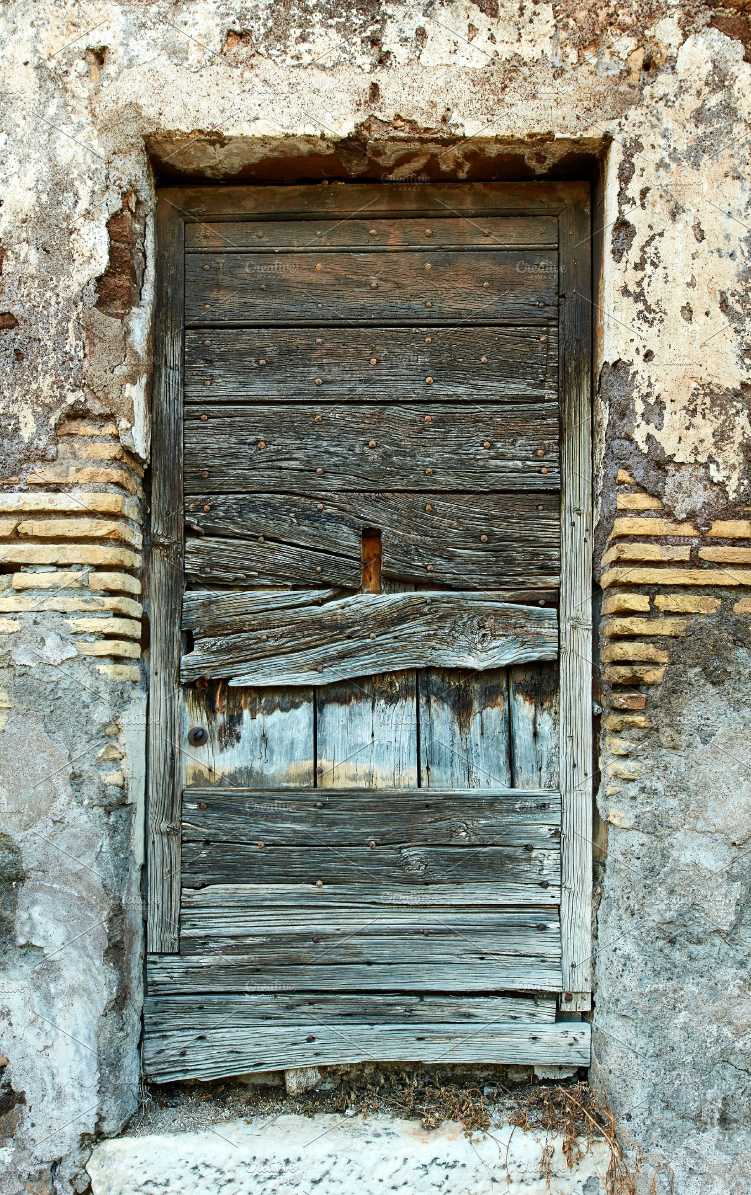
Rev. 3²⁰ Behold, I stand at the door, and knock: if any man hear my voice, and open the door, I will come in to him, and will sup with him, and he with me.

