Slide 1
When we all get to Heaven
Revelation 4 and chapter 5

Slide 2
What is the theme of this book?
What is the outline?
Why do you want to go to Heaven?

Slide 3
Rapture
4 After this I looked, and, behold, a door was opened in heaven: and the first voice which I heard was as it were of a trumpet talking with me; which said, Come up hither, and I will shew thee things which must be hereafter.

Slide 4
The two objects of what he seen?
² And immediately I was in the spirit: and, behold, a throne was set in heaven, and one sat on the throne.
³ And he that sat was to look upon like a jasper and a sardine stone: and there was a rainbow round about the throne, in sight like unto an emerald.

Slide 6
Audience #1
⁴ And round about the throne were four and twenty seats: and upon the seats I saw four and twenty elders sitting, clothed in white raiment; and they had on their heads crowns of gold.

Slide 7
Throne – (Lightnings, Thunder, Number 7, 7 Spirits)
⁵ And out of the throne proceeded lightnings and thunderings and voices: and there were seven lamps of fire burning before the throne, which are the seven Spirits of God.

Slide 8
Throne and Audience #2
⁶ And before the throne there was a sea of glass like unto crystal: and in the midst of the throne, and round about the throne, were four beasts full of eyes before and behind.

Slide 9
Audience #2 and Worship
⁷ And the first beast was like a lion, and the second beast like a calf, and the third beast had a face as a man, and the fourth beast was like a flying eagle.
⁸ And the four beasts had each of them six wings about him; and they were full of eyes within: and they rest not day and night, saying, Holy, holy, holy, Lord God Almighty, which was, and is, and is to come.
⁹ And when those beasts give glory and honour and thanks to him that sat on the throne, who liveth for ever and ever,

Slide 11
The Worship
¹⁰ The four and twenty elders fall down before him that sat on the throne, and worship him that liveth for ever and ever, and cast their crowns before the throne, saying,
¹¹ Thou art worthy, O Lord, to receive glory and honour and power: for thou hast created all things, and for thy pleasure they are and were created.

Slide 12
Summary

Slide 13
Chapter 5 – Scene continued (v 1-4 The Book)
5 And I saw in the right hand of him that sat on the throne a book written within and on the backside, sealed with seven seals.
² And I saw a strong angel proclaiming with a loud voice, Who is worthy to open the book, and to loose the seals thereof?
³ And no man in heaven, nor in earth, neither under the earth, was able to open the book, neither to look thereon.

Slide 14
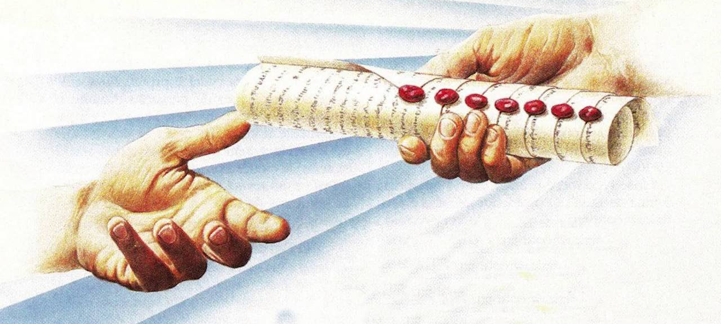
#1 The Book
⁴ And I wept much, because no man was found worthy to open and to read the book, neither to look thereon.

Slide 15
#2 (V 5 – 7) The Lion and The Lamb

Slide 16
⁵ And one of the elders saith unto me, Weep not: behold, the Lion of the tribe of Judah, the Root of David, hath prevailed to open the book, and to loose the seven seals thereof.
⁶ And I beheld, and, lo, in the midst of the throne and of the four beasts, and in the midst of the elders, stood a Lamb as it had been slain, having seven horns and seven eyes, which are the seven Spirits of God sent forth into all the earth.
⁷ And he came and took the book out of the right hand of him that sat upon the throne.

Slide 17
#3 The Worship v 8 - 14
⁸ And when he had taken the book, the four beasts and four and twenty elders fell down before the Lamb, having every one of them harps, and golden vials full of odours, which are the prayers of saints.
⁹ And they sung a new song, saying, Thou art worthy to take the book, and to open the seals thereof: for thou wast slain, and hast redeemed us to God by thy blood out of every kindred, and tongue, and people, and nation;
¹⁰ And hast made us unto our God kings and priests: and we shall reign on the earth.

Slide 18
¹¹ And I beheld, and I heard the voice of many angels round about the throne and the beasts and the elders: and the number of them was ten thousand times ten thousand, and thousands of thousands;
¹² Saying with a loud voice, Worthy is the Lamb that was slain to receive power, and riches, and wisdom, and strength, and honour, and glory, and blessing.
“7 Verse Worship song!”

Slide 19
¹³ And every creature which is in heaven, and on the earth, and under the earth, and such as are in the sea, and all that are in them, heard I saying, Blessing, and honour, and glory, and power, be unto him that sitteth upon the throne, and unto the Lamb for ever and ever.
¹⁴ And the four beasts said, Amen. And the four and twenty elders fell down and worshipped him that liveth for ever and ever.

