Slide 1
Rock or Sand
Matthew 7

Slide 2
Need – Two responses to Consider
“The Stability of my life depends on how I respond to these words!”
“My Eternal Destiny depends on how I respond to these words!”

Slide 3
^{Matthew 7:24} Therefore whosoever heareth these sayings of mine, and doeth them, I will liken him unto a wise man, which built his house upon a rock:
²⁵ And the rain descended, and the floods came, and the winds blew, and beat upon that house; and it fell not: for it was founded upon a rock.
²⁶ And every one that heareth these sayings of mine, and doeth them not, shall be likened unto a foolish man, which built his house upon the sand:

Slide 4
²⁷ And the rain descended, and the floods came, and the winds blew, and beat upon that house; and it fell: and great was the fall of it.
²⁸ And it came to pass, when Jesus had ended these sayings, the people were astonished at his doctrine:
²⁹ For he taught them as one having authority, and not as the scribes.

Slide 5
#1 Storms
“Rain descended” – adversity from above me
“Floods came” – adversity from below me
“Winds blew” – adversity from around me
Thought #1 – “Storms will come in my life prepared or not!”

Slide 6
#1 Storms
Thought #2 “I cannot control my storm when it comes!”
Thought #3 “I can be ready for the storm!”

Slide 7
#2 Building a House / Building a life
How am I building?
Thought #1 “Every person has a house (life) to build!”
Thought #2 “How I build my house will make a difference!”
“I am building today on what I completed yesterday, and it will determine my tomorrow!”

Slide 8
#3 Heard the Words of Jesus
“I have access to the instructions and the manual for building a stable and successful life!”

Slide 9
#4 Two Builders - Foolish
“Moros” – moron
“He hears the instructions but chooses not to follow or submit to them!”
#1 – There are many who will hear, but few are willing to heed!
#2 – He is not changed by what he hears!

Slide 10
#4 Two Builders - Wise
Intelligent, prudent, smart.
He was a doer (maker, poet, carrier out, performer)!
James 1²² But be ye doers of the word, and not hearers only, deceiving your own selves.
“If your religion doesn’t change you, you need to change your religion!”

Slide 11
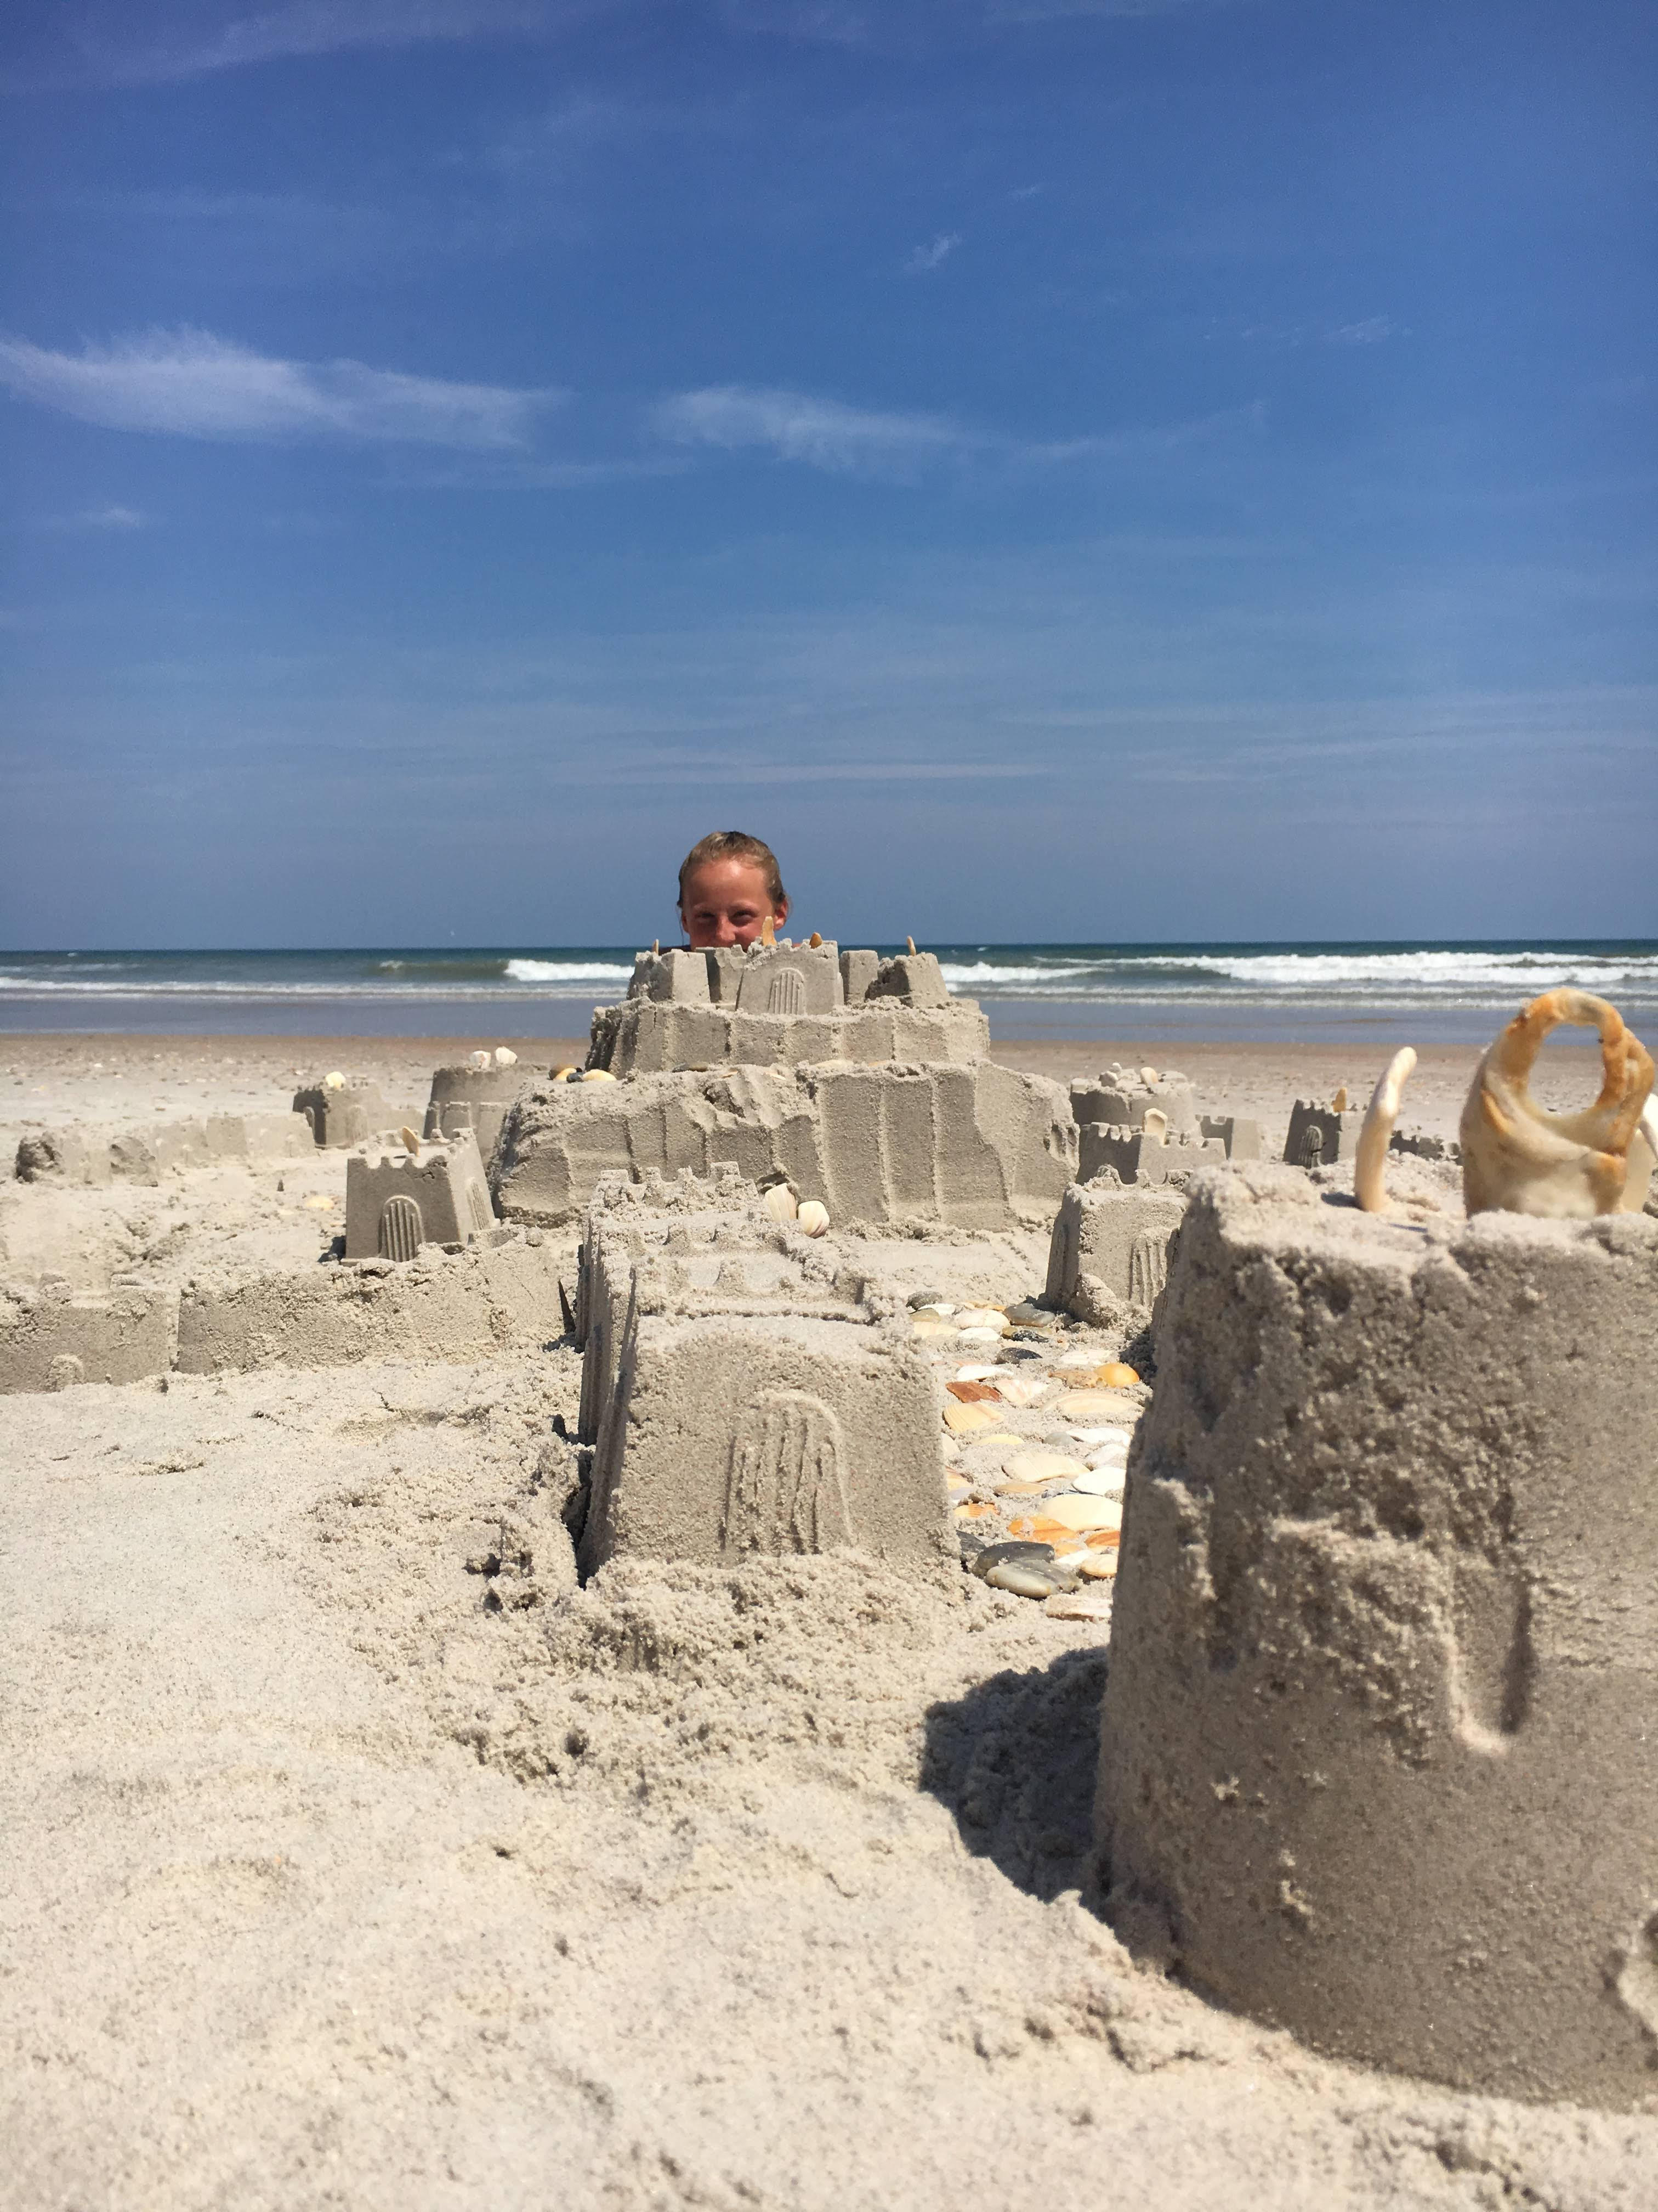
#5 Two Foundations - Sand
World, Flesh, Fame
#1 A very shallow house
#2 Although it is quick and easy, it is not built to last!

Slide 12
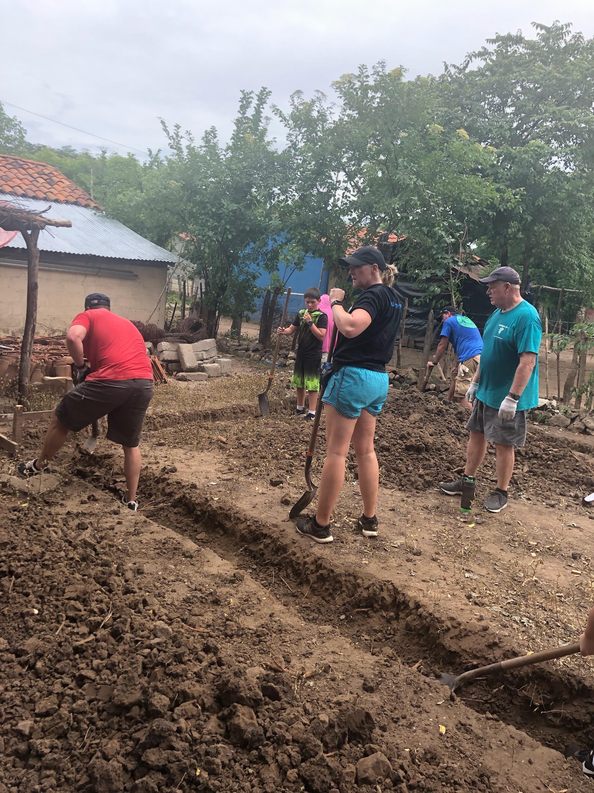
#5 Two Foundations - Rock
You must dig deep (Luke 6:48)
I Corinthians 3¹¹ For other foundation can no man lay than that is laid, which is Jesus Christ.
#1 Jesus my Rock and my Foundation!

Slide 13
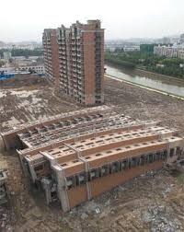
#6 Two Results
If a person builds his life upon Christ, It never falls no matter what the storm!
“Far more momentous than the choice even of a life-work or of a life-partner is the choice about life itself.”

