Slide 1
^{2 Timothy 1:6} Wherefore I put thee in remembrance that thou stir up the gift of God, which is in thee by the putting on of my hands.
⁷ For God hath not given us the spirit of fear; but of power, and of love, and of a sound mind.
⁸ Be not thou therefore ashamed of the testimony of our Lord, nor of me his prisoner: but be thou partaker of the afflictions of the gospel according to the power of God;

Slide 2
Be Legendary
No Fear
2 Timothy 1:7

Slide 3
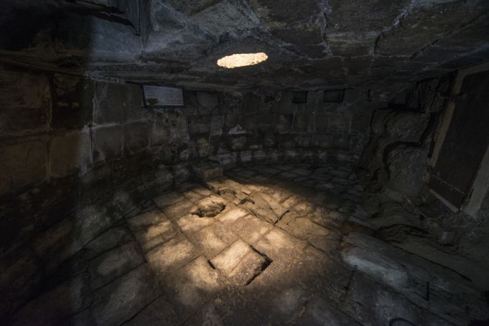
Background: Legend Paul writes to Timothy

Slide 4
⁷ For God hath not given us the spirit of fear
Emotion vs. Spirit
Gen 3:10 And he said, I heard thy voice in the garden, and I was afraid,
“A messed up alarm system!”

Slide 5
What is there to be afraid of?

Slide 6
#1 The Spirit of Fear
⁷ For God hath not given us the spirit of fear
“To Control who you think your God is!”
Daniel 3 “We are not careful to answer thee …..Our God is able to deliver us….. But if not we will still not bow and serve you and your gods!”

Slide 7
#1 The Spirit of Fear
V 6 “…….thou stir up the gift of God, which is in thee”
“Control who you think you are!”
David and Goliath
Dt 1²⁹ Then I said unto you, Dread not, neither be afraid of them.
³⁰ The Lord your God which goeth before you, he shall fight for you,

Slide 8
#1 The Spirit of Fear
V 8 “…… Be not thou therefore ashamed”
“Control what you think you should do”
I Kings 19:3 And when he saw that, he arose, and went for his life,

Slide 9
#2 The Spirit of Christ
⁷ For God hath not given us the spirit of fear; but of power, and of love, and of a sound mind.
“This is the kind of Person that God makes!”

Slide 10
Close: Should I fear?
For God?
For eternity?
Of Death?
Hebrews 2:15 And deliver them who through fear of death were all their lifetime subject to bondage.

