Slide 1
^{2 Timothy 1: 8} Be not thou therefore ashamed of the testimony of our Lord, nor of me his prisoner: but be thou partaker of the afflictions of the gospel according to the power of God;
⁹ Who hath saved us, and called us with an holy calling, not according to our works, but according to his own purpose and grace, which was given us in Christ Jesus before the world began,
¹⁰ But is now made manifest by the appearing of our Saviour Jesus Christ, who hath abolished death, and hath brought life and immortality to light through the gospel:

Slide 2
Be Legendary
#3 “Not Ashamed”
2 Timothy 1:7 - 10

Slide 3
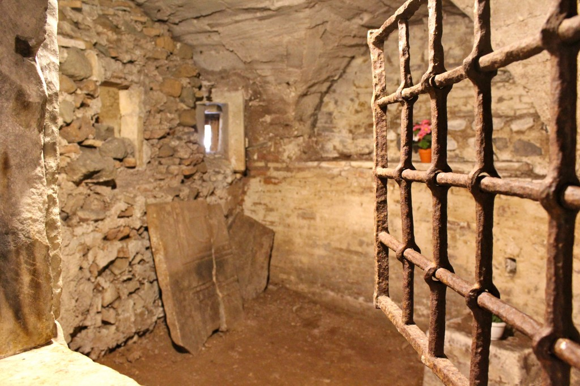

Slide 4
⁶ Wherefore I put thee in remembrance that thou stir up the gift of God, which is in thee by the putting on of my hands.
⁷ For God hath not given us the spirit of fear; but of power, and of love, and of a sound mind.

Slide 5
#1 Don’t Be Ashamed!
⁸ Be not thou therefore ashamed of the testimony of our Lord, nor of me his prisoner: but be thou partaker of the afflictions of the gospel according to the power of God;
“Ashamed of What?”
“Ashamed Why?”
“Let us not be ashamed of who we are, whose we are, or of his message!”

Slide 6
This one attitude is the underlying factor to being effective. No matter how educated or talented your are, if you don’t have the courage you will not speak!
“Why should I not be ashamed?”

Slide 7
#2 The God of My Salvation
⁹ Who hath saved us, and called us with an holy calling, not according to our works, but according to his own purpose and grace, which was given us in Christ Jesus before the world began,

Slide 8
#3 Jesus Christ our Savior
¹⁰ But is now made manifest by the appearing of our Saviour Jesus Christ, who hath abolished death, and hath brought life and immortality to light through the gospel:
Not R.I.P. for me, but C.A.D.

Slide 9
Application
#1 Cannot be effective.
#2 Mark 8³⁸ Whosoever therefore shall be ashamed of me and of my words in this adulterous and sinful generation; of him also shall the Son of man be ashamed, when he cometh in the glory of his Father with the holy angels.

