Slide 1
Legendary “Be Strong”
2 Timothy 2 and I Corinthians 9

Slide 2
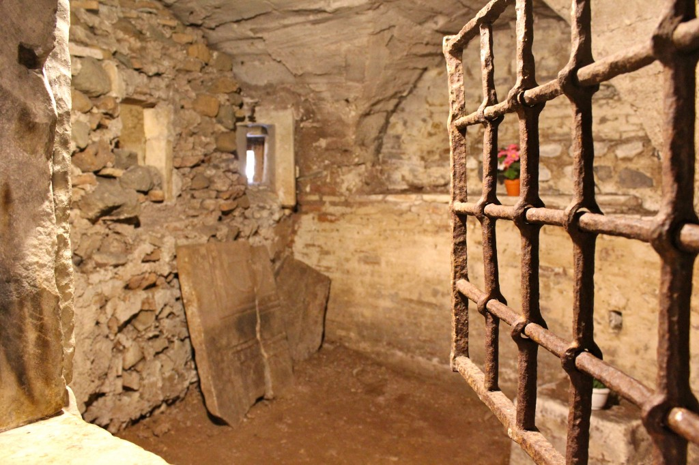

Slide 3
2:1 Thou therefore, my son, be strong in the grace that is in Christ Jesus.
Teacher, Soldier, Athlete, Farmer
“Is what you are willing to give up now , worth what you will be gaining?”

Slide 4
⁵ And if a man also strive for masteries, yet is he not crowned, except he strive lawfully.
True Born Greek
Train for 10 months
Stay within the Rules

Slide 5
Ephesians 6¹² For we wrestle not against flesh and blood, but against principalities, against powers, against the rulers of the darkness of this world, against spiritual wickedness in high places.
Which Team am I on?

Slide 6
^{I Corinthians 9:24} Know ye not that they which run in a race run all, but one receiveth the prize? So run, that ye may obtain.
²⁵ And every man that striveth for the mastery is temperate in all things. Now they do it to obtain a corruptible crown; but we an incorruptible.
²⁶ I therefore so run, not as uncertainly; so fight I, not as one that beateth the air:
²⁷ But I keep under my body, and bring it into subjection: lest that by any means, when I have preached to others, I myself should be a castaway.

Slide 7
Takeaway #1 -Discipline – Training and Practice
²⁶ I therefore so run, not as uncertainly; so fight I, not as one that beateth the air:
“The goal of discipline is about being not just doing?”
“Do I practice the Christian Disciplines?”

Slide 8
Takeaway #3 -Discipline – Self denial (Sacrifice)
²⁵ And every man that striveth for the mastery is temperate in all things.
²⁷ But I keep under my body, and bring it into subjection:
“Is there something I need to say No to?”

Slide 9
Take away #3 – Discipline – by the Rules
^{2 Timothy 2:5} And if a man also strive for masteries, yet is he not crowned, except he strive lawfully.
Am I following Christ?

Slide 10
Exhortations – Discipline - motivation
^{I Corinthians 9:24} Know ye not that they which run in a race run all, but one receiveth the prize? So run, that ye may obtain. (Win)
²⁵ And every man that striveth for the mastery is temperate in all things. Now they do it to obtain a corruptible crown; but we an incorruptible. (Prize)
²⁷ But I keep under my body, and bring it into subjection: lest that by any means, when I have preached to others, I myself should be a castaway. (Disqualified)

Slide 11
Exhortations
Be on the right TEAM
Practice Christian Disciplines
Deny self
Win a Crown

