Slide 1
A Wise Christmas
Matthew 2

Slide 2
Mt. 2:1 Now when Jesus was born in Bethlehem of Judaea in the days of Herod the king, behold, there came wise men from the east to Jerusalem,
² Saying, Where is he that is born King of the Jews? for we have seen his star in the east, and are come to worship him.
³ When Herod the king had heard these things, he was troubled, and all Jerusalem with him.

Slide 3
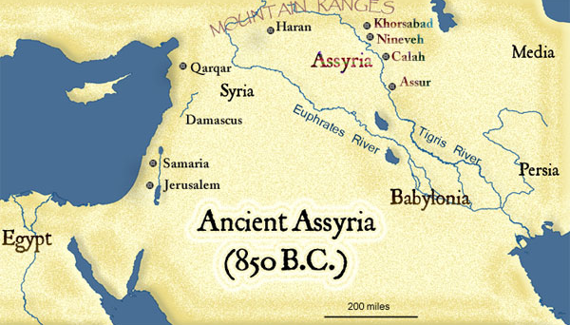
I. Who are they?
1. Magio – Gr.
2. From the East
Persia
Mesopotamia
Babylonian
Medo-Persian
Parthenian

Slide 4
“Magi” – Daniel 2:2
Babylonian Empire – Jer. 39:3 and Daniel
Persian Empire (Judge and King makers) Esther 1:13 – 19
“Throughout history, they were intelligent men who assumed positions of power and prominence as advisors, judges, and king makers.”

Slide 5
II. How did they Know?
Word of God: Balaam – Numbers 24:17, Daniel 2:44, Daniel 9.
Star of God: “Miraculous acts of God all around us!”
Spirit of God: Pulling their heart.
“God has done the same for us!”

Slide 6
Point #1 - “Wise Men Trust God!”
“History is God’s sovereignty at Work!”
“Do you trust God even in the trails?”
“Do not compromise, you never know what God is up to.”

Slide 7
⁴ And when he had gathered all the chief priests and scribes of the people together, he demanded of them where Christ should be born.
⁵ And they said unto him, In Bethlehem of Judaea: for thus it is written by the prophet,
⁶ And thou Bethlehem, in the land of Juda, art not the least among the princes of Juda: for out of thee shall come a Governor, that shall rule my people Israel.

Slide 8
⁷ Then Herod, when he had privily called the wise men, enquired of them diligently what time the star appeared.
⁸ And he sent them to Bethlehem, and said, Go and search diligently for the young child; and when ye have found him, bring me word again, that I may come and worship him also.
⁹ When they had heard the king, they departed; and, lo, the star, which they saw in the east, went before them, till it came and stood over where the young child was.

Slide 9
¹⁰ When they saw the star, they rejoiced with exceeding great joy.
¹¹ And when they were come into the house, they saw the young child with Mary his mother, and fell down, and worshipped him: and when they had opened their treasures, they presented unto him gifts; gold, and frankincense and myrrh.

Slide 10
III. What they did
Point #2- Searched: “Wise men seek Jesus!”
Point #3 Fell Down: “Wise men surrender to Jesus!”
Point #4 Worshipped him:
Gold: “Wise Men worship him as King.”
Frankincense: “Wise Men worship him as God.”
Myrrh: “Wise Men worship him for his death and resurrection.”

Slide 11
Do I trust God?
Am I searching for Jesus?
Have I surrendered my life to him completely?
Am I worshipping him?

