Slide 1
What Can I do?
Take Care of Others
Nehemiah 4

Slide 2
Review
“Take Care of You!” – Jeremiah and the book of Lamentations
Humble
Hope
Seek
Worship

Slide 3
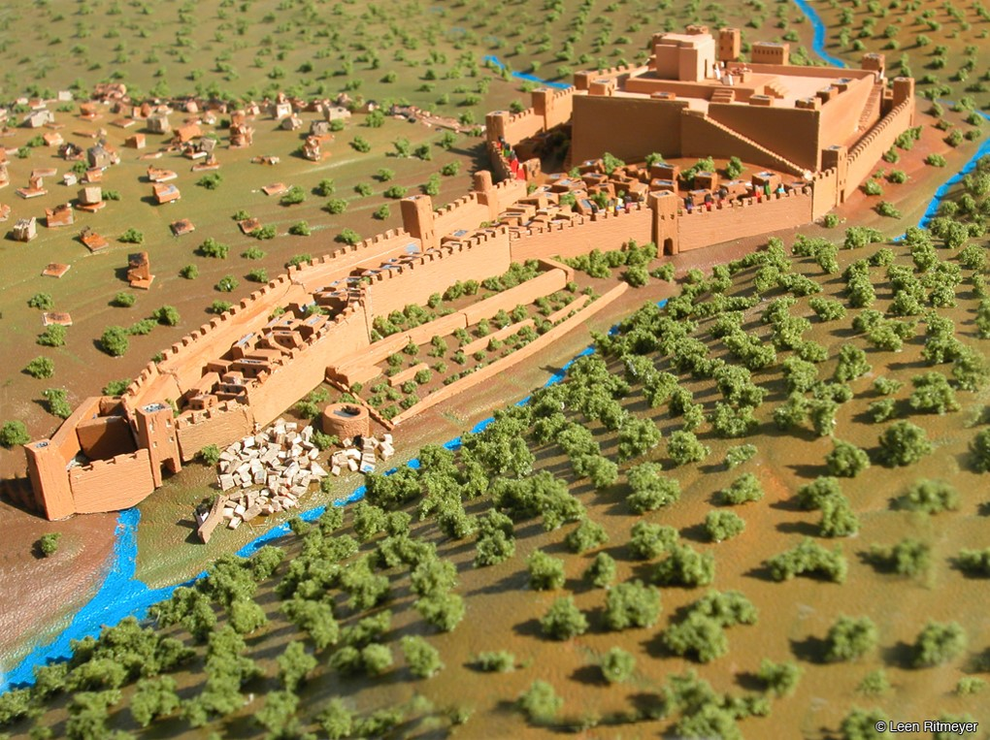
Background
Nehemiah
The Wall
“God had not forgotten his people. He would send a leader who would bring restoration!”

Slide 4
We will face opposition
4 But it came to pass, that when Sanballat heard that we builded the wall, he was wroth, and took great indignation, and mocked the Jews.
² And he spake before his brethren and the army of Samaria, and said, What do these feeble Jews? will they fortify themselves? will they sacrifice? will they make an end in a day? will they revive the stones out of the heaps of the rubbish which are burned?
³ Now Tobiah the Ammonite was by him, and he said, Even that which they build, if a fox go up, he shall even break down their stone wall.

Slide 5
A mind to work
⁶ So built we the wall; and all the wall was joined together unto the half thereof: for the people had a mind to work.

Slide 6
We will face Opposition
⁷ But it came to pass, that when Sanballat, and Tobiah, and the Arabians, and the Ammonites, and the Ashdodites, heard that the walls of Jerusalem were made up, and that the breaches began to be stopped, then they were very wroth,
⁸ And conspired all of them together to come and to fight against Jerusalem, and to hinder it.

Slide 7
We will face Opposition!
#USA #Wise Co #MTO

Slide 8
We will not be discouraged
¹⁰ And Judah said, The strength of the bearers of burdens is decayed, and there is much rubbish; so that we are not able to build the wall.
Worry
Doubt
Quit
Blame
Motivates

Slide 9
We will not be discouraged
#USA #WiseCo #MTO
We will be careful with our Words
#USA #WiseCo #MTO

Slide 10
We will not be Controlled by Fear!
¹⁴ And I looked, and rose up, and said unto the nobles, and to the rulers, and to the rest of the people, Be not ye afraid of them: remember the Lord, which is great and terrible, and fight for your brethren, your sons, and your daughters, your wives, and your houses.

Slide 11
We will not be controlled by FEAR!
#USA #WiseCo #MTO

Slide 12
We Will Stand Together
¹⁶ And it came to pass from that time forth, that the half of my servants wrought in the work, and the other half of them held both the spears, the shields, and the bows, and the habergeons; and the rulers were behind all the house of Judah.
¹⁷ They which builded on the wall, and they that bare burdens, with those that laded, every one with one of his hands wrought in the work, and with the other hand held a weapon.

Slide 13
WE Will Stand Together
#USA #WiseCo #MTO

Slide 14
“God had not forgotten his people. He would send a leader who would bring restoration!”

