Slide 1
Revelation chapter 9:13- Chapter 10

Slide 2
#1) In Revelation 1:19, Jesus gives the outline of the book to John. He says write the things which you have seen (Rev chp1) and write the things which will be hereafter (Rev. chp 4 – end). What is the middle part of the outline and what chapters does it refer to in the Book of Revelation?
Chp. 1
What you have seen
??
Chp 4 till end
Things hereafter

Slide 3
Things that are (church age) chapters 2-3.

Slide 4
#2) In this study, what major event have we identified as happening in chapter 4?
The Rapture of the Church

Slide 5
#3) In Chapter 5, Jesus is shown as receiving what, which has information concerning the destiny or end time events?
A Book or Scroll sealed with Seven Seals

Slide 6
#4) In Chapter 6, we start the events of the 7 years of ……….
Tribulation

Slide 7
#5)Fill in the blank, “There are (# ) Seals, and each seal represents a major that happens in the Tribulation period.
7, Event

Slide 8
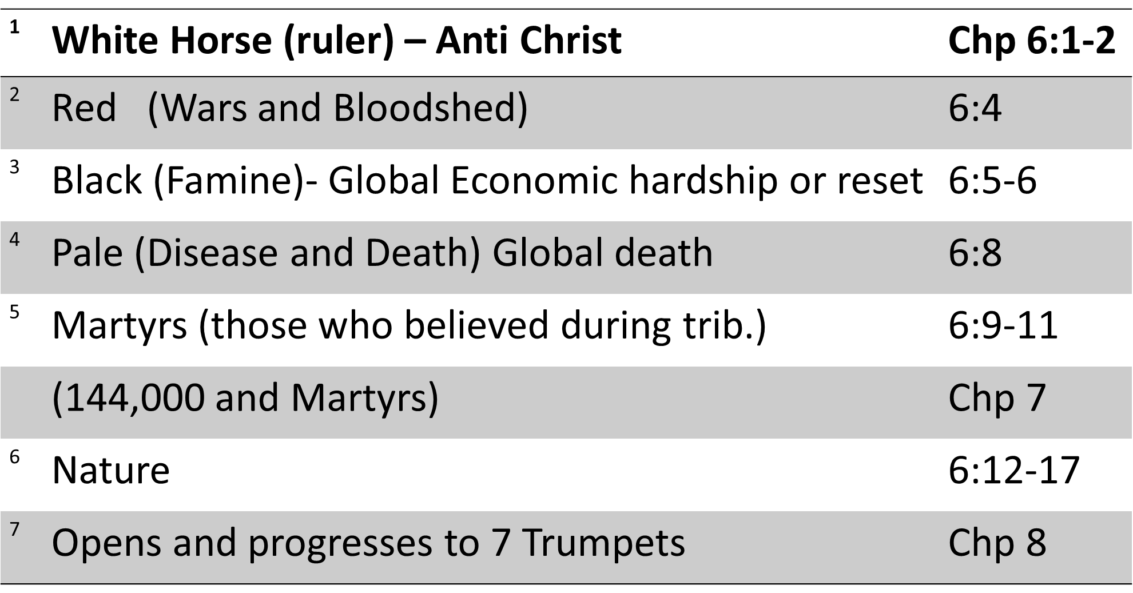
#6) Name at least Two of the 7 Seal Events that start with the 4 horseman.

Slide 9
#7) In Chapter 8, We start the Trumpet events which bring us to the midpoint (3.5 years) of the 7 Year tribulation. How many Trumpets are listed?
7

Slide 10
Trumpets
1 Vegetation
2 Sea as blood
3 Fresh water is bitter
4 eclipse
5 Locusts

Slide 11
Chapter 9 ³ And there came out of the smoke locusts upon the earth: and unto them was given power, as the scorpions of the earth have power.
1. Literal
2. Demons illustrated by John

Slide 12
¹³ And the sixth angel sounded, and I heard a voice from the four horns of the golden altar which is before God,
¹⁴ Saying to the sixth angel which had the trumpet, Loose the four angels which are bound in the great river Euphrates.
The 4 Angels (wicked Angels that are bound).
The Great River Euphrates
Boundary of East and West.

Slide 13
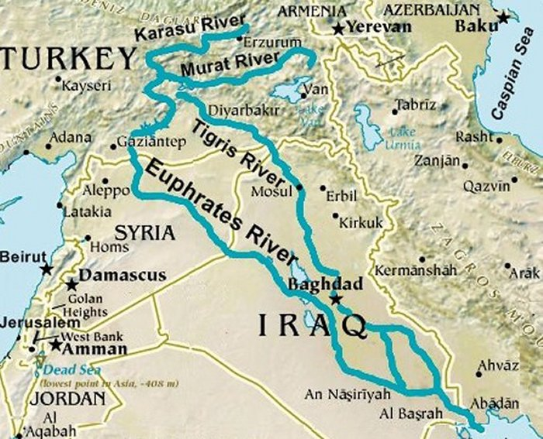

Slide 14
¹⁵ And the four angels were loosed, which were prepared for an hour, and a day, and a month, and a year, for to slay the third part of men.
God is in control. God is an on time God!

Slide 15
¹⁶ And the number of the army of the horsemen were two hundred thousand thousand: and I heard the number of them. (200 million)
¹⁷ And thus I saw the horses in the vision, and them that sat on them, having breastplates of fire, and of jacinth, and brimstone: and the heads of the horses were as the heads of lions; and out of their mouths issued fire and smoke and brimstone.
¹⁸ By these three was the third part of men killed, by the fire, and by the smoke, and by the brimstone, which issued out of their mouths.

Slide 16
¹⁹ For their power is in their mouth, and in their tails: for their tails were like unto serpents, and had heads, and with them they do hurt.
²⁰ And the rest of the men which were not killed by these plagues yet repented not of the works of their hands, that they should not worship devils, and idols of gold, and silver, and brass, and stone, and of wood: which neither can see, nor hear, nor walk:
²¹ Neither repented they of their murders, nor of their sorceries, nor of their fornication, nor of their thefts.
Pharmakeion – deception of Drug and addictions.

Slide 17
2 Thess 2⁷ For the mystery of iniquity doth already work: only he who now letteth will let, until he be taken out of the way.
⁸ And then shall that Wicked be revealed, whom the Lord shall consume with the spirit of his mouth, and shall destroy with the brightness of his coming:
⁹ Even him, whose coming is after the working of Satan with all power and signs and lying wonders,
¹⁰ And with all deceivableness of unrighteousness in them that perish; because they received not the love of the truth, that they might be saved.
¹¹ And for this cause God shall send them strong delusion, that they should believe a lie:

Slide 18
Danger of Hard Heartedness
Does not obey
Does not change
Stops recognizing God
Does not recognize the authority of God or his word
Does not see the chaos of life that surrounds them
Blames God, God’s message, and God’s messenger
Will not be broken

Slide 19
Parenthetical Passage
10:1 And I saw another mighty angel come down from heaven, clothed with a cloud: and a rainbow was upon his head, and his face was as it were the sun, and his feet as pillars of fire:
² And he had in his hand a little book open: and he set his right foot upon the sea, and his left foot on the earth,
The Angel: one of special forces, uniform, book, standing!

Slide 20
³ And cried with a loud voice, as when a lion roareth: and when he had cried, seven thunders uttered their voices.
⁴ And when the seven thunders had uttered their voices, I was about to write: and I heard a voice from heaven saying unto me, Seal up those things which the seven thunders uttered, and write them not.
A reference to the voice of God in traditional Jewish belief.

Slide 21
Lord speak to us, through us and for us!
Psalms 29³ The voice of the Lord is upon the waters: the God of glory thundereth: the Lord is upon many waters.
⁴ The voice of the Lord is powerful; the voice of the Lord is full of majesty.
⁵ The voice of the Lord breaketh the cedars; yea, the Lord breaketh the cedars of Lebanon.
⁶ He maketh them also to skip like a calf; Lebanon and Sirion like a young unicorn.
⁷ The voice of the Lord divideth the flames of fire.⁸ The voice of the Lord shaketh the wilderness; the Lord shaketh the wilderness of Kadesh.
⁹ The voice of the Lord maketh the hinds to calve, and discovereth the forests: and in his temple doth every one speak of his glory.

Slide 22
⁵ And the angel which I saw stand upon the sea and upon the earth lifted up his hand to heaven,
⁶ And sware by him that liveth for ever and ever, who created heaven, and the things that therein are, and the earth, and the things that therein are, and the sea, and the things which are therein, that there should be time no longer:
⁷ But in the days of the voice of the seventh angel, when he shall begin to sound, the mystery of God should be finished, as he hath declared to his servants the prophets.
⁸ And the voice which I heard from heaven spake unto me again, and said, Go and take the little book which is open in the hand of the angel which standeth upon the sea and upon the earth.

Slide 23
⁹ And I went unto the angel, and said unto him, Give me the little book. And he said unto me, Take it, and eat it up; and it shall make thy belly bitter, but it shall be in thy mouth sweet as honey.
¹⁰ And I took the little book out of the angel's hand, and ate it up; and it was in my mouth sweet as honey: and as soon as I had eaten it, my belly was bitter.
¹¹ And he said unto me, Thou must prophesy again before many peoples, and nations, and tongues, and kings.
Jeremiah 15:16, Ezekiel 3:1-3
Psalms 119¹⁰³ How sweet are thy words unto my taste! yea, sweeter than honey to my mouth!

