Slide 1
Meet the Beast
Revelation chapter 13 part 2

Slide 2
13 And I stood upon the sand of the sea, and saw a beast rise up out of the sea, having seven heads and ten horns, and upon his horns ten crowns, and upon his heads the name of blasphemy.
² And the beast which I saw was like unto a leopard, and his feet were as the feet of a bear, and his mouth as the mouth of a lion: and the dragon gave him his power, and his seat, and great authority.

Slide 3
³ And I saw one of his heads as it were wounded to death; and his deadly wound was healed: and all the world wondered after the beast.
2 Theories on the Wound
Actual Person and Even
Actual Empire

Slide 4
⁴ And they worshipped the dragon which gave power unto the beast: and they worshipped the beast, saying, Who is like unto the beast? who is able to make war with him?
Satanic Worship
Anti-Christ Worship

Slide 5
⁵ And there was given unto him a mouth speaking great things and blasphemies; and power was given unto him to continue forty and two months.⁶ And he opened his mouth in blasphemy against God, to blaspheme his name, and his tabernacle, and them that dwell in heaven.

Slide 6
⁷ And it was given unto him to make war with the saints, and to overcome them: and power was given him over all kindreds, and tongues, and nations. ⁸ And all that dwell upon the earth shall worship him, whose names are not written in the book of life of the Lamb slain from the foundation of the world.

Slide 7
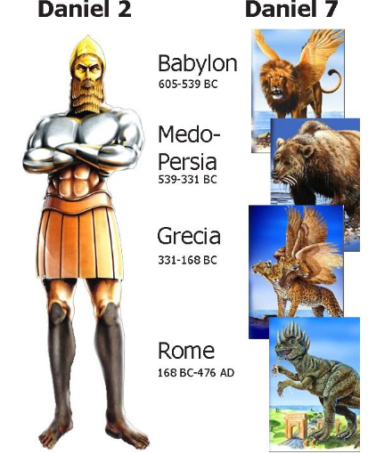

Slide 8
²⁴ And the ten horns out of this kingdom are ten kings that shall arise: and another shall rise after them; and he shall be diverse from the first, and he shall subdue three kings.²⁵ And he shall speak great words against the most High, and shall wear out the saints of the most High, and think to change times and laws: and they shall be given into his hand until a time and times and the dividing of time.

Slide 9
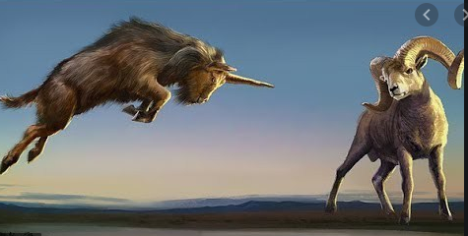
Daniel 8: 20-22
Alexander
323 B.C.
Greece
Media-Persia

Slide 10
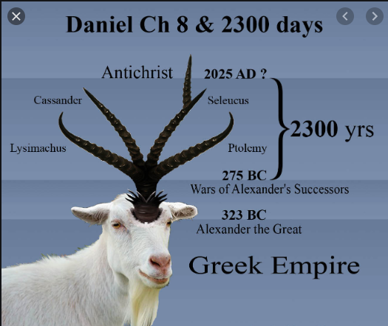

Slide 11
²³ And in the latter time of their kingdom, when the transgressors are come to the full, a king of fierce countenance, and understanding dark sentences, shall stand up. ²⁴ And his power shall be mighty, but not by his own power: and he shall destroy wonderfully, and shall prosper, and practise, and shall destroy the mighty and the holy people.

Slide 12
²⁵ And through his policy also he shall cause craft to prosper in his hand; and he shall magnify himself in his heart, and by peace shall destroy many: he shall also stand up against the Prince of princes; but he shall be broken without hand.

Slide 13
³⁶ And the king shall do according to his will; and he shall exalt himself, and magnify himself above every god, and shall speak marvellous things against the God of gods, and shall prosper till the indignation be accomplished: for that that is determined shall be done.

Slide 14
³⁷ Neither shall he regard the God of his fathers, nor the desire of women, nor regard any god: for he shall magnify himself above all.
Religion

Slide 15
³⁸ But in his estate shall he honour the God of forces: and a god whom his fathers knew not shall he honour with gold, and silver, and with precious stones, and pleasant things.
War
Materialistic (Deep State)

Slide 16
³⁹ Thus shall he do in the most strong holds with a strange god, whom he shall acknowledge and increase with glory: and he shall cause them to rule over many, and shall divide the land for gain.

