Slide 1
Share on Facebook
Mt. Olive Church – Wise Va
Get Service info
mountolivechurch.net (blog)

Slide 2
Heaven is………
Revelation 21
“Lets Go Together”

Slide 3
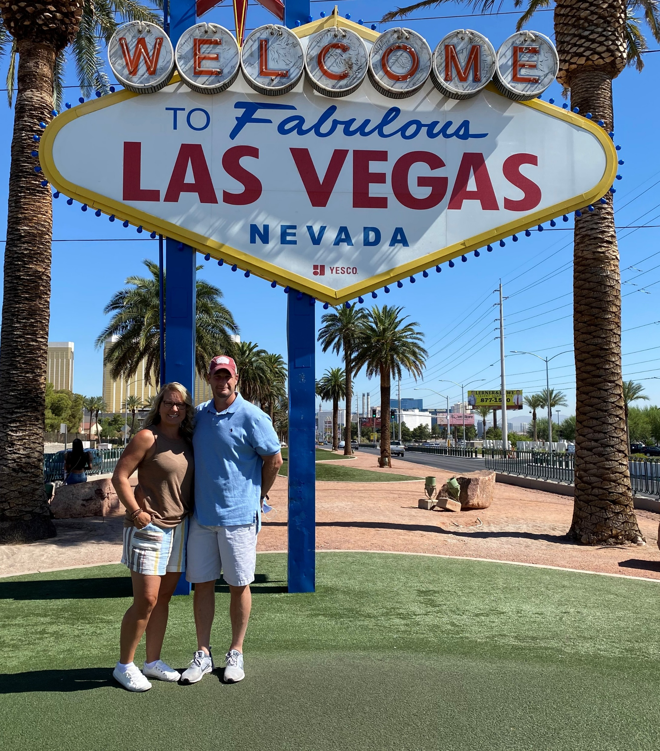
Tour of Heaven

Slide 4
Heaven is NEW
⁵ And he that sat upon the throne said, Behold, I make all things new. And he said unto me, Write: for these words are true and faithful.
⁶ And he said unto me, It is done. I am Alpha and Omega, the beginning and the end. I will give unto him that is athirst of the fountain of the water of life freely.

Slide 5
New Things
City v 2-3
Conditions v 4
Heaven
Earth v1

Slide 6
New Heaven and Earth
21 And I saw a new heaven and a new earth: for the first heaven and the first earth were passed away; and there was no more sea.

Slide 7
Pass Away
^{3 Peter 3:10} But the day of the Lord will come as a thief in the night; in the which the heavens shall pass away with a great noise, and the elements shall melt with fervent heat, the earth also and the works that are therein shall be burned up.

Slide 8
Take Home
God Remains
Word Remains
Soul Remains

Slide 9
New City (Hunger for Heaven)
² And I John saw the holy city, new Jerusalem, coming down from God out of heaven, prepared as a bride adorned for her husband.
³ And I heard a great voice out of heaven saying, Behold, the tabernacle of God is with men, and he will dwell with them, and they shall be his people, and God himself shall be with them, and be their God.

Slide 10
Heavenly Hunger
God’s
Dwelling
Man’s
Dwelling

Slide 11
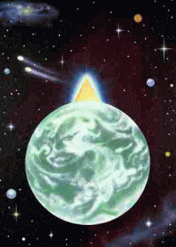

Slide 12
New Conditions
⁴ And God shall wipe away all tears from their eyes; and there shall be no more death, neither sorrow, nor crying, neither shall there be any more pain: for the former things are passed away.

Slide 13
View of Suffering
^{2 Corinthians 4:17} For our light affliction, which is but for a moment, worketh for us a far more exceeding and eternal weight of glory;

Slide 14
⁵ And he that sat upon the throne said, Behold, I make all things new. And he said unto me, Write: for these words are true and faithful.
⁶ And he said unto me, It is done. I am Alpha and Omega, the beginning and the end. I will give unto him that is athirst of the fountain of the water of life freely.

Slide 15
New You
^{2 Corinthians 5:17} Therefore if any man be in Christ, he is a new creature: old things are passed away; behold, all things are become new.

Slide 16
Lets Go together
⁸ But the fearful, and unbelieving, and the abominable, and murderers, and whoremongers, and sorcerers, and idolaters, and all liars, shall have their part in the lake which burneth with fire and brimstone: which is the second death.

