Slide 1
Share on Facebook
Mt. Olive Church – Wise Va
Get Service info
mountolivechurch.net (blog)

Slide 2
Heaven is ……..
“Lets Go Together”
Revelation 21

Slide 3
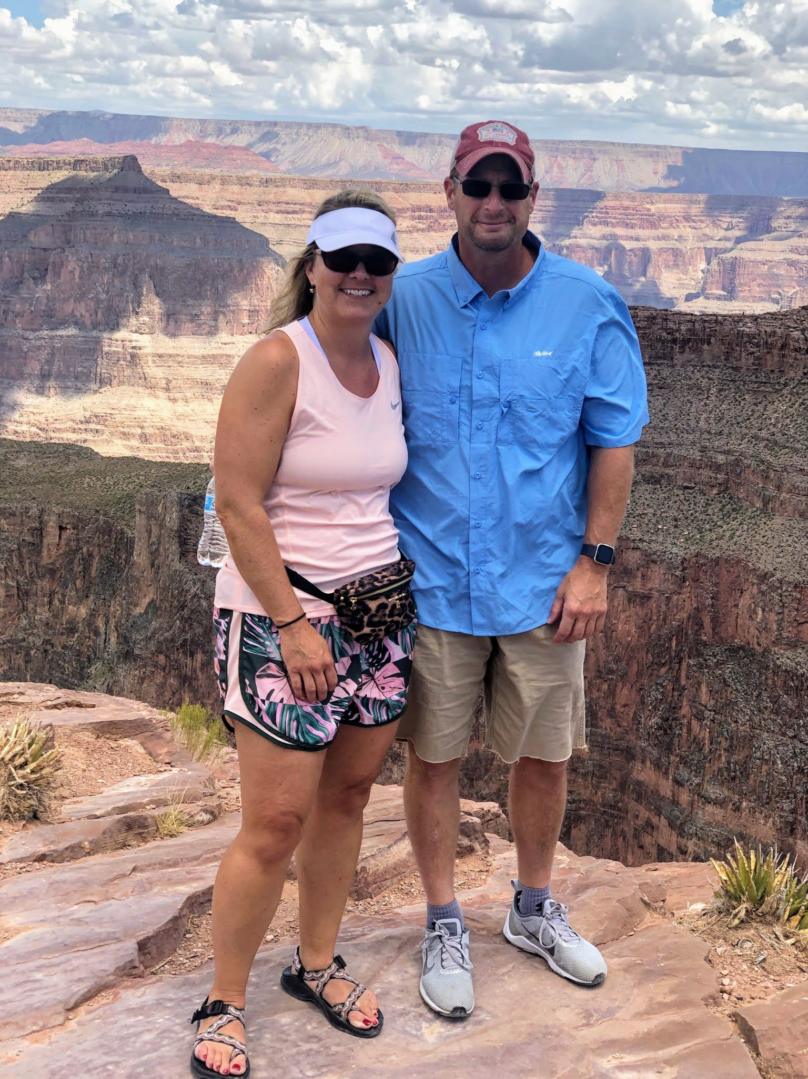

Slide 4
Heaven is Perfect
²⁷ And there shall in no wise enter into it any thing that defileth, neither whatsoever worketh abomination, or maketh a lie: but they which are written in the Lamb's book of life.

Slide 5
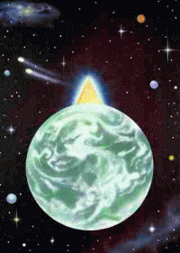
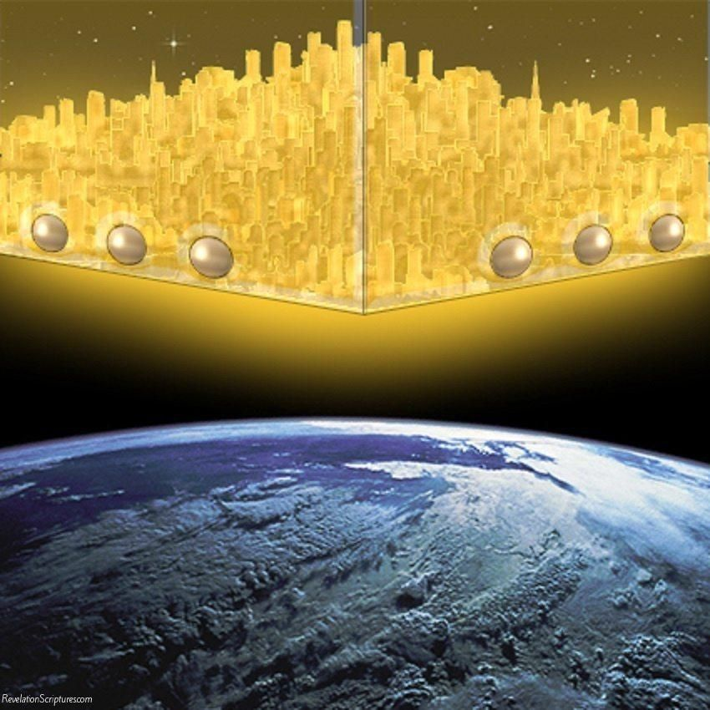

Slide 6
Perfect in Size
¹⁶ And the city lieth foursquare, and the length is as large as the breadth: and he measured the city with the reed, twelve thousand furlongs. The length and the breadth and the height of it are equal.
1,500 miles perfect square (Cube)

Slide 7
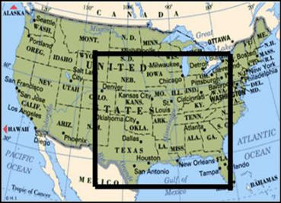

Slide 8
Perfect in Beauty
¹⁸ And the building of the wall of it was of jasper: and the city was pure gold, like unto clear glass.
¹⁹ And the foundations of the wall of the city were garnished with all manner of precious stones. The first foundation was jasper; the second, sapphire; the third, a chalcedony; the fourth, an emerald;

Slide 9
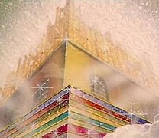
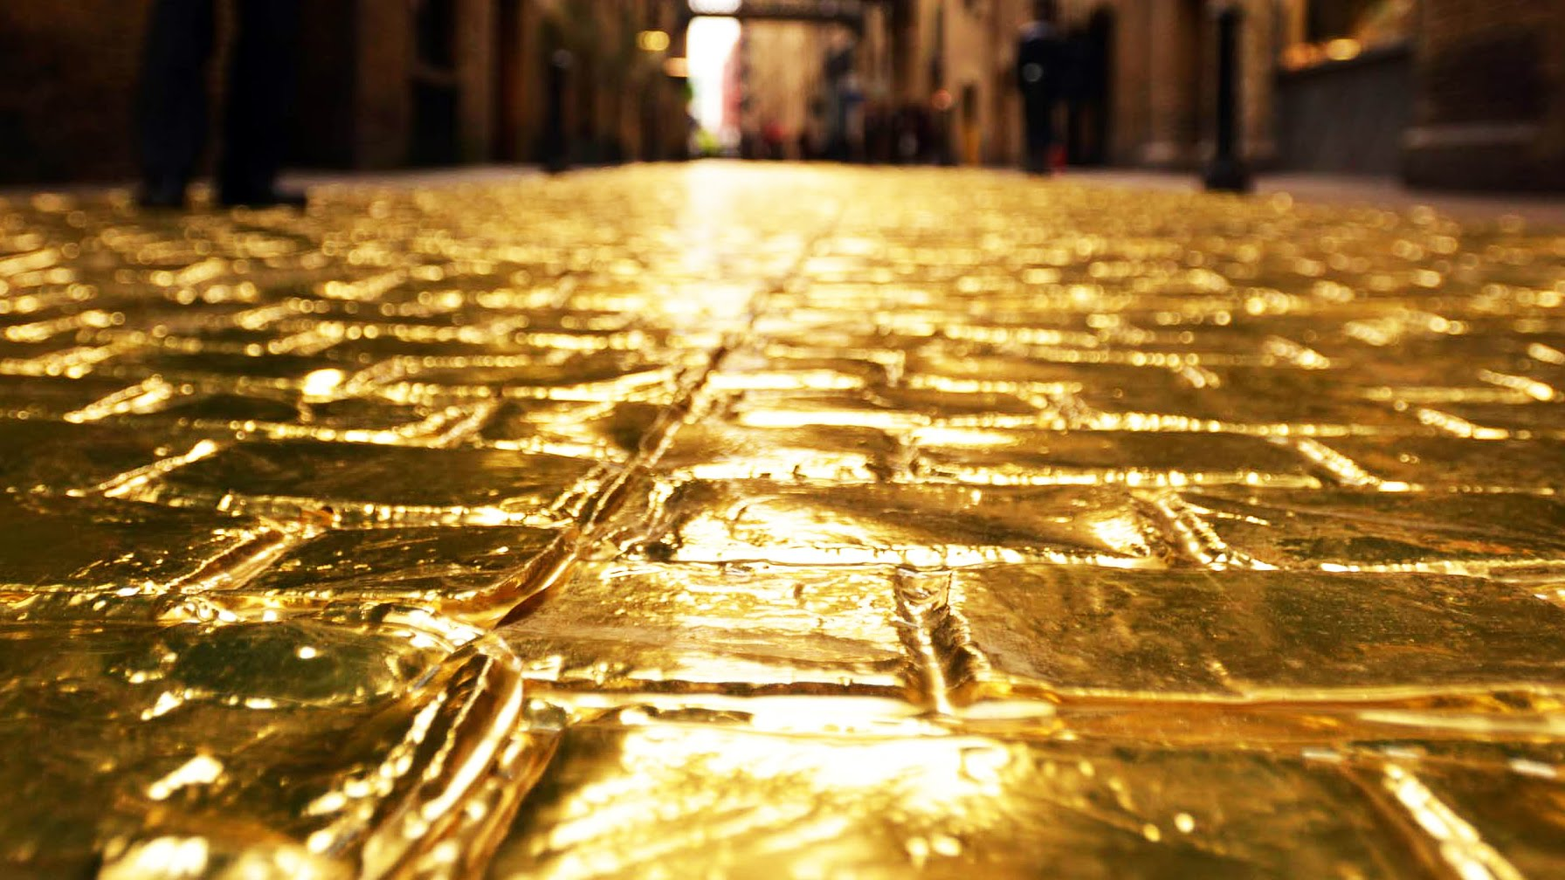

Slide 10
Perfect in Protection
¹² And had a wall great and high, and had twelve gates, and at the gates twelve angels, and names written thereon, which are the names of the twelve tribes of the children of Israel:
¹⁷ And he measured the wall thereof, an hundred and forty and four cubits, according to the measure of a man, that is, of the angel.

Slide 11
Perfect in Peace
²⁵ And the gates of it shall not be shut at all by day: for there shall be no night there.
²⁷ And there shall in no wise enter into it any thing that defileth, neither whatsoever worketh abomination, or maketh a lie: but they which are written in the Lamb's book of life.

Slide 12
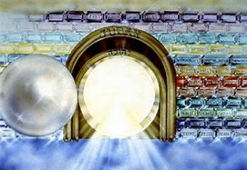

Slide 13
Perfect Peace
²¹ And the twelve gates were twelve pearls: every several gate was of one pearl: and the street of the city was pure gold, as it were transparent glass.

Slide 14
The Happy Ending
^{2 Corinthians 4:17} For our light affliction, which is but for a moment, worketh for us a far more exceeding and eternal weight of glory;

Slide 15
²⁷ And there shall in no wise enter into it any thing that defileth, neither whatsoever worketh abomination, or maketh a lie: but they which are written in the Lamb's book of life.

