Slide 1
The Great Chapter
Revelation 16

Slide 3
Overview
Event | Vials
Earth | V 2
Sea | V 3
Rivers | V 4
Sun | V 8
Darkness | V 10
Euphrates | v12
Earthquakes | V 18

Slide 4
16 And I heard a great voice out of the temple saying to the seven angels, Go your ways, and pour out the vials of the wrath of God upon the earth.
² And the first went, and poured out his vial upon the earth; and there fell a noisome and grievous sore upon the men which had the mark of the beast, and upon them which worshipped his image.
³ And the second angel poured out his vial upon the sea; and it became as the blood of a dead man: and every living soul died in the sea.⁴ And the third angel poured out his vial upon the rivers and fountains of waters; and they became blood.

Slide 5
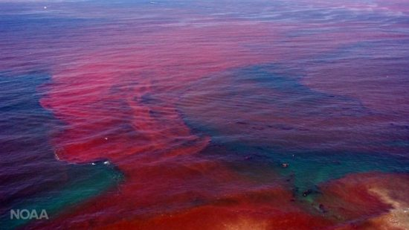
The algae linked to red tides contain a toxin that affects the nervous and digestive systems of animals. Red tides are usually accompanied by a massive die-off of fish, as well as the birds and other animals that feed on fish.

Slide 7
Who is God
⁵ And I heard the angel of the waters say, Thou art righteous, O Lord, which art, and wast, and shalt be, because thou hast judged thus.
⁶ For they have shed the blood of saints and prophets, and thou hast given them blood to drink; for they are worthy.
⁷ And I heard another out of the altar say, Even so, Lord God Almighty, true and righteous are thy judgments.

Slide 8
⁸ And the fourth angel poured out his vial upon the sun; and power was given unto him to scorch men with fire.
⁹ And men were scorched with great heat, and blasphemed the name of God, which hath power over these plagues: and they repented not to give him glory.
¹⁰ And the fifth angel poured out his vial upon the seat of the beast; and his kingdom was full of darkness; and they gnawed their tongues for pain,
¹¹ And blasphemed the God of heaven because of their pains and their sores, and repented not of their deeds.

Slide 9
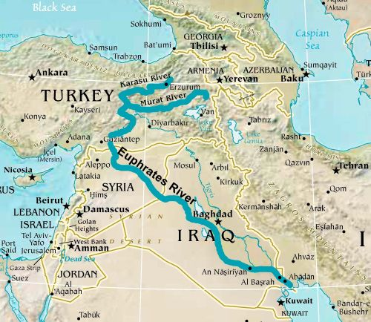
6th
¹² And the sixth angel poured out his vial upon the great river Euphrates; and the water thereof was dried up, that the way of the kings of the east might be prepared.

Slide 10
Gen 2: 10 - 14

Slide 11
Application: God is faithful (Gen 15:18)
I Corinthians 10¹³ There hath no temptation taken you but such as is common to man: but God is faithful, who will not suffer you to be tempted above that ye are able; but will with the temptation also make a way to escape, that ye may be able to bear it.

Slide 12
Daniel 11⁴⁴ But tidings out of the east and out of the north shall trouble him: therefore he shall go forth with great fury to destroy, and utterly to make away many.

Slide 13
¹³ And I saw three unclean spirits like frogs come out of the mouth of the dragon, and out of the mouth of the beast, and out of the mouth of the false prophet.
¹⁴ For they are the spirits of devils, working miracles, which go forth unto the kings of the earth and of the whole world, to gather them to the battle of that great day of God Almighty.

Slide 14
Application: Need a foundation of truth
John 17¹⁷ Sanctify them through thy truth: thy word is truth.

Slide 15
Thief – Application – “Be Ready”
¹⁵ Behold, I come as a thief. Blessed is he that watcheth, and keepeth his garments, lest he walk naked, and they see his shame.
Tell me how to be ready: Clothed with Salvation, Devoted to Disciplines, Alert and awake (IThess5:6), Looking (Titus 2:13), Faithful.

Slide 16
¹⁶ And he gathered them together into a place called in the Hebrew tongue Armageddon.
¹⁷ And the seventh angel poured out his vial into the air; and there came a great voice out of the temple of heaven, from the throne, saying, It is done.

Slide 18
It is Done (Mountain or a Plain)
John 19²⁸ After this, Jesus knowing that all things were now accomplished, that the scripture might be fulfilled, saith, I thirst.
²⁹ Now there was set a vessel full of vinegar: and they filled a spunge with vinegar, and put it upon hyssop, and put it to his mouth.
³⁰ When Jesus therefore had received the vinegar, he said, It is finished: and he bowed his head, and gave up the ghost.

Slide 19
¹⁸ And there were voices, and thunders, and lightnings; and there was a great earthquake, such as was not since men were upon the earth, so mighty an earthquake, and so great.
¹⁹ And the great city was divided into three parts, and the cities of the nations fell: and great Babylon came in remembrance before God, to give unto her the cup of the wine of the fierceness of his wrath.
²⁰ And every island fled away, and the mountains were not found.
²¹ And there fell upon men a great hail out of heaven, every stone about the weight of a talent: and men blasphemed God because of the plague of the hail; for the plague thereof was exceeding great.

