Slide 1
The Great Chapter
Revelation 16

Slide 2
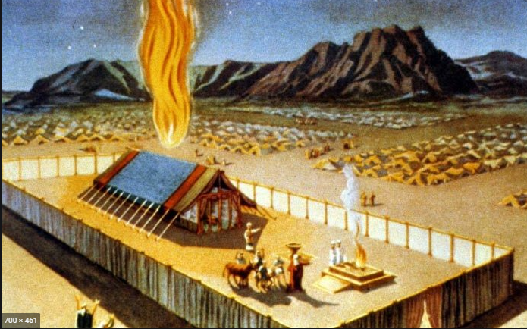

Slide 3
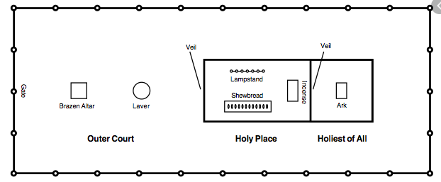

Slide 4
Background
Event | Trumpets | Vials
Earth | 8:7 (fire and blood) | V 2
Sea | 8:8 (Mtn into Sea) | V 3
Rivers | 8:10 (Star Wormwood) | V 4
Sun | 8:12 (Sun darkened) | V 8
Darkness | 9:2 (smoke from pit) | V 10
Euphrates | 9:14 (bound angels) | v12
Earthquakes | 11:13 (2 Witnesses die) | V 18

Slide 5
#1 Where, What, Who
16 And I heard a great voice out of the temple saying to the seven angels, Go your ways, and pour out the vials of the wrath of God upon the earth.
² And the first went, and poured out his vial upon the earth; and there fell a noisome and grievous sore upon the men which had the mark of the beast, and upon them which worshipped his image.
Exodus 9: 8 - 12

Slide 6
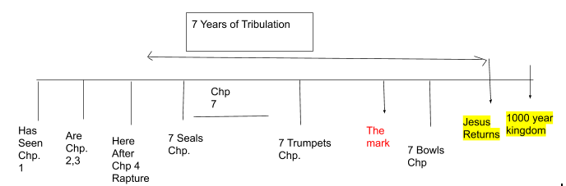

Slide 7
2nd and 3rd – Where, What, Who
³ And the second angel poured out his vial upon the sea; and it became as the blood of a dead man: and every living soul died in the sea.
⁴ And the third angel poured out his vial upon the rivers and fountains of waters; and they became blood.
Exodus 7:19-25

Slide 8
Who is God
⁵ And I heard the angel of the waters say, Thou art righteous, O Lord, which art, and wast, and shalt be, because thou hast judged thus.
⁶ For they have shed the blood of saints and prophets, and thou hast given them blood to drink; for they are worthy.
⁷ And I heard another out of the altar say, Even so, Lord God Almighty, true and righteous are thy judgments.

Slide 9
The 4th
⁸ And the fourth angel poured out his vial upon the sun; and power was given unto him to scorch men with fire.
⁹ And men were scorched with great heat, and blasphemed the name of God, which hath power over these plagues: and they repented not to give him glory.
“Be careful not to let hearts get hardened!”

Slide 10
5th
¹⁰ And the fifth angel poured out his vial upon the seat of the beast; and his kingdom was full of darkness; and they gnawed their tongues for pain,
¹¹ And blasphemed the God of heaven because of their pains and their sores, and repented not of their deeds.
Seat (Rev. 11: 1-2, Dan 9:27)
Exodus 10: 21 - 23

Slide 11
6th (2 Chronicles 18: 18 – 22)
¹² And the sixth angel poured out his vial upon the great river Euphrates; and the water thereof was dried up, that the way of the kings of the east might be prepared.
¹³ And I saw three unclean spirits like frogs come out of the mouth of the dragon, and out of the mouth of the beast, and out of the mouth of the false prophet.
¹⁴ For they are the spirits of devils, working miracles, which go forth unto the kings of the earth and of the whole world, to gather them to the battle of that great day of God Almighty.

