Slide 1
Share on Facebook
Mt. Olive Church – Wise Va
Get Service info
mountolivechurch.net (blog)

Slide 2
Heaven is Lit
Revelation 21

Slide 4
Heaven has no Darkness!!!!
²³ And the city had no need of the sun, neither of the moon, to shine in it: for the glory of God did lighten it, and the Lamb is the light thereof.

Slide 5
Darkness
Evil, Corruption
Death
Unbelief/Doubt
Lack of Understanding
Hate
Fear, Depression
Stumbles
No direction
Presence of Satan
Hide
Lies, deception
Chaos,Division
Hell

Slide 6
#1 Heaven has no darkness
^{I John 1:5} This then is the message which we have heard of him, and declare unto you, that God is light, and in him is no darkness at all.

Slide 7
Light
Life
Good
Understanding
Belief
Love
Peace
Joy
Confidence
Illuminates
Direction
Reveals
Truth
Unity
Presence of God
Heaven

Slide 8
“Come to the Light”
John 8¹² Then spake Jesus again unto them, saying, I am the light of the world: he that followeth me shall not walk in darkness, but shall have the light of life.
Only Solution to the darkness we face.

Slide 9
“Believers walk in the light”
^{I John 1: 6} If we say that we have fellowship with him, and walk in darkness, we lie, and do not the truth:
⁷ But if we walk in the light, as he is in the light, we have fellowship one with another, and the blood of Jesus Christ his Son cleanseth us from all sin.

Slide 10
#2 “Light is everywhere I Go!”
²⁴ And the nations of them which are saved shall walk in the light of it: and the kings of the earth do bring their glory and honour into it.

Slide 11
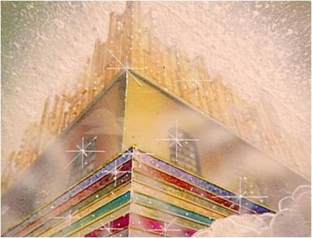
Matthew 5¹⁴ Ye are the light of the world. A city that is set on an hill cannot be hid.

Slide 12
#3 “There is no Night”
²⁵ And the gates of it shall not be shut at all by day: for there shall be no night there.

Slide 13
Experience that Rest
Matthew 11²⁸ Come unto me, all ye that labour and are heavy laden, and I will give you rest.

