Slide 1
New World Order
Empire 2 – Assyria

Slide 2
Revelation 17
Religion
Politics
Economic

Slide 3
Mystery Babylon
Genesis 10 – All the Nations of the World.
Genesis 11 – How God separated them.
Tower of Babel: City, Name, Temple.
Main Characters:
Nimrod
Semiramis
Tammuz

Slide 4
¹⁰ And there are seven kings: five are fallen, and one is, and the other is not yet come; and when he cometh, he must continue a short space.
Mede/
Persia
Greece
Roman
Egypt
Assyria
Babylon

Slide 5
Egypt – Exodus chp 1 Political Ruling Elite – Isaiah 52:4 Government Control Enemy of the State

Slide 6
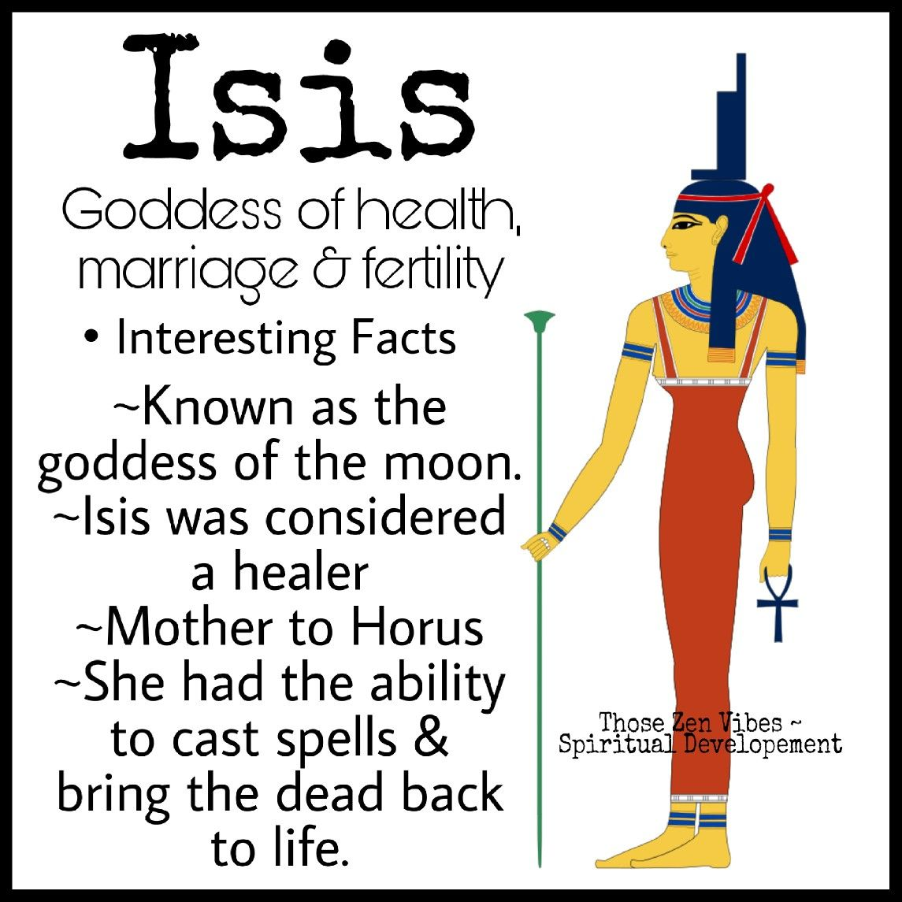
Osiris
Religion -Exodus 5:2 Want you to forget!

Slide 7
Assyrian

Slide 8
Timeline
2000-1365 B.C. | 1365 – 1208 B.C. | 1208 – 911 | 911 – 613 B.C.
Start | Early | Decline | Rise
Gen 10:11 Gen 14 |  | Glory Days Israel | Jonah 1:1-3

Slide 9
Assyrian

Slide 10
Ezekiel 31
Taller than –Imperialism
Watered – sources of income
Deep state control
Reach of Influence
Problem is Pride

Slide 11
God’s Tool
Isaiah 8:7
Isaiah 9:6
Isaiah 10:5 – “Nations can be used as God’s tool.”

Slide 12
Political
II Kings 9- 10 | Jehu | Tribute to Assyria
2 Kings 15:19 | Menaham | Tribute to Assyria
2 Kings 16:6=9 | Ahaz | Alliance with Assyria
2 Kings 17: 1-6, 23 | North Israel | Captives
2 Kings 18:7, 13 – 17 | Hezekiah | Captives

Slide 13
Religious
Isaiah 37:38 | Asshur | 710 B.C.
Jeremiah 10 (Tree) | Tammuz / Nimrod | 600 B.C.
Ezekiel 8:14 | Tammuz | 594 B.C.
II Kings 10:25-28 | Baal | 884 B.C.

Slide 14
Assyria

Slide 15
I Kings 18 – Jezebel and Elijah
V 17 Who is the problem
V 21 National Decision
V 30 Stop worship
V 37 Turn our hearts
19: 1 – 3 Intolerant.

