Slide 1
One World Order
Part 2

Slide 2
Revelation 17
Religion
Politics
Economic

Slide 3
¹⁰ And there are seven kings: five are fallen, and one is, and the other is not yet come; and when he cometh, he must continue a short space.
Mede/
Persia
Greece
Roman
Egypt
Assyria
Babylon

Slide 4
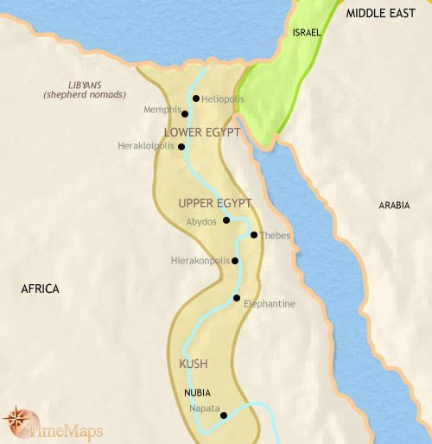
Egypt – Exodus chp 1
Political

Slide 5
Political
Ruling Elite – Isaiah 52:4
Government Control
Enemy of the State

Slide 6
Religion
Exodus 5:2
Want you to forget!

Slide 7
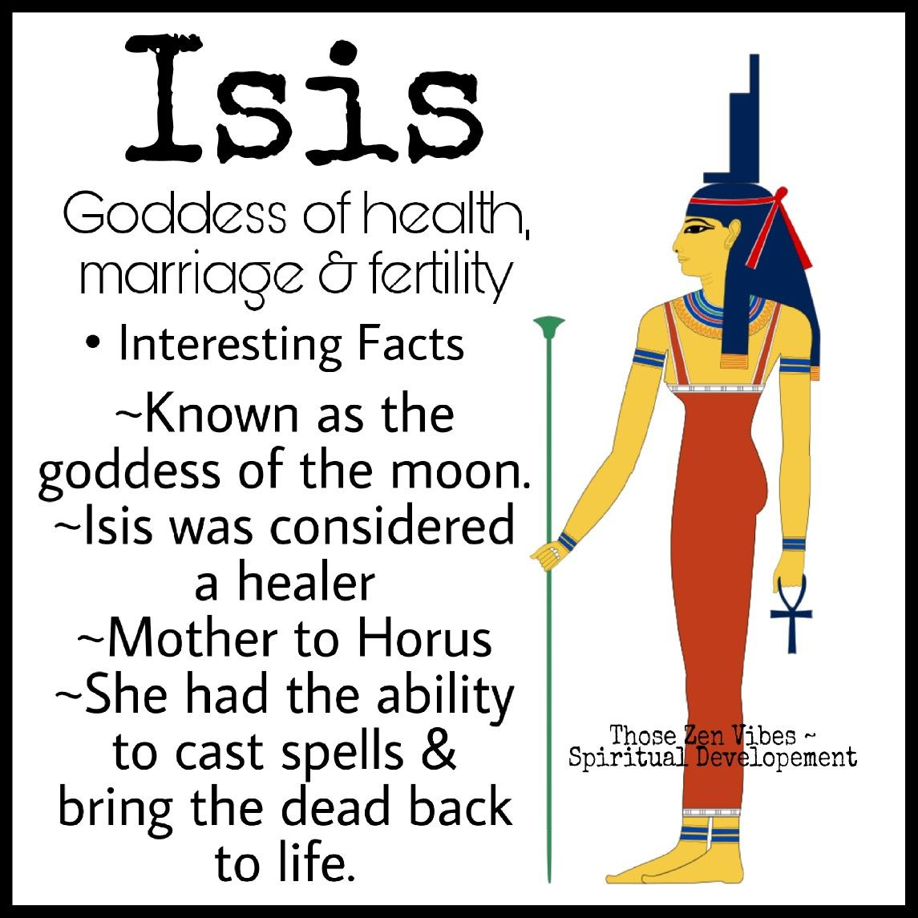
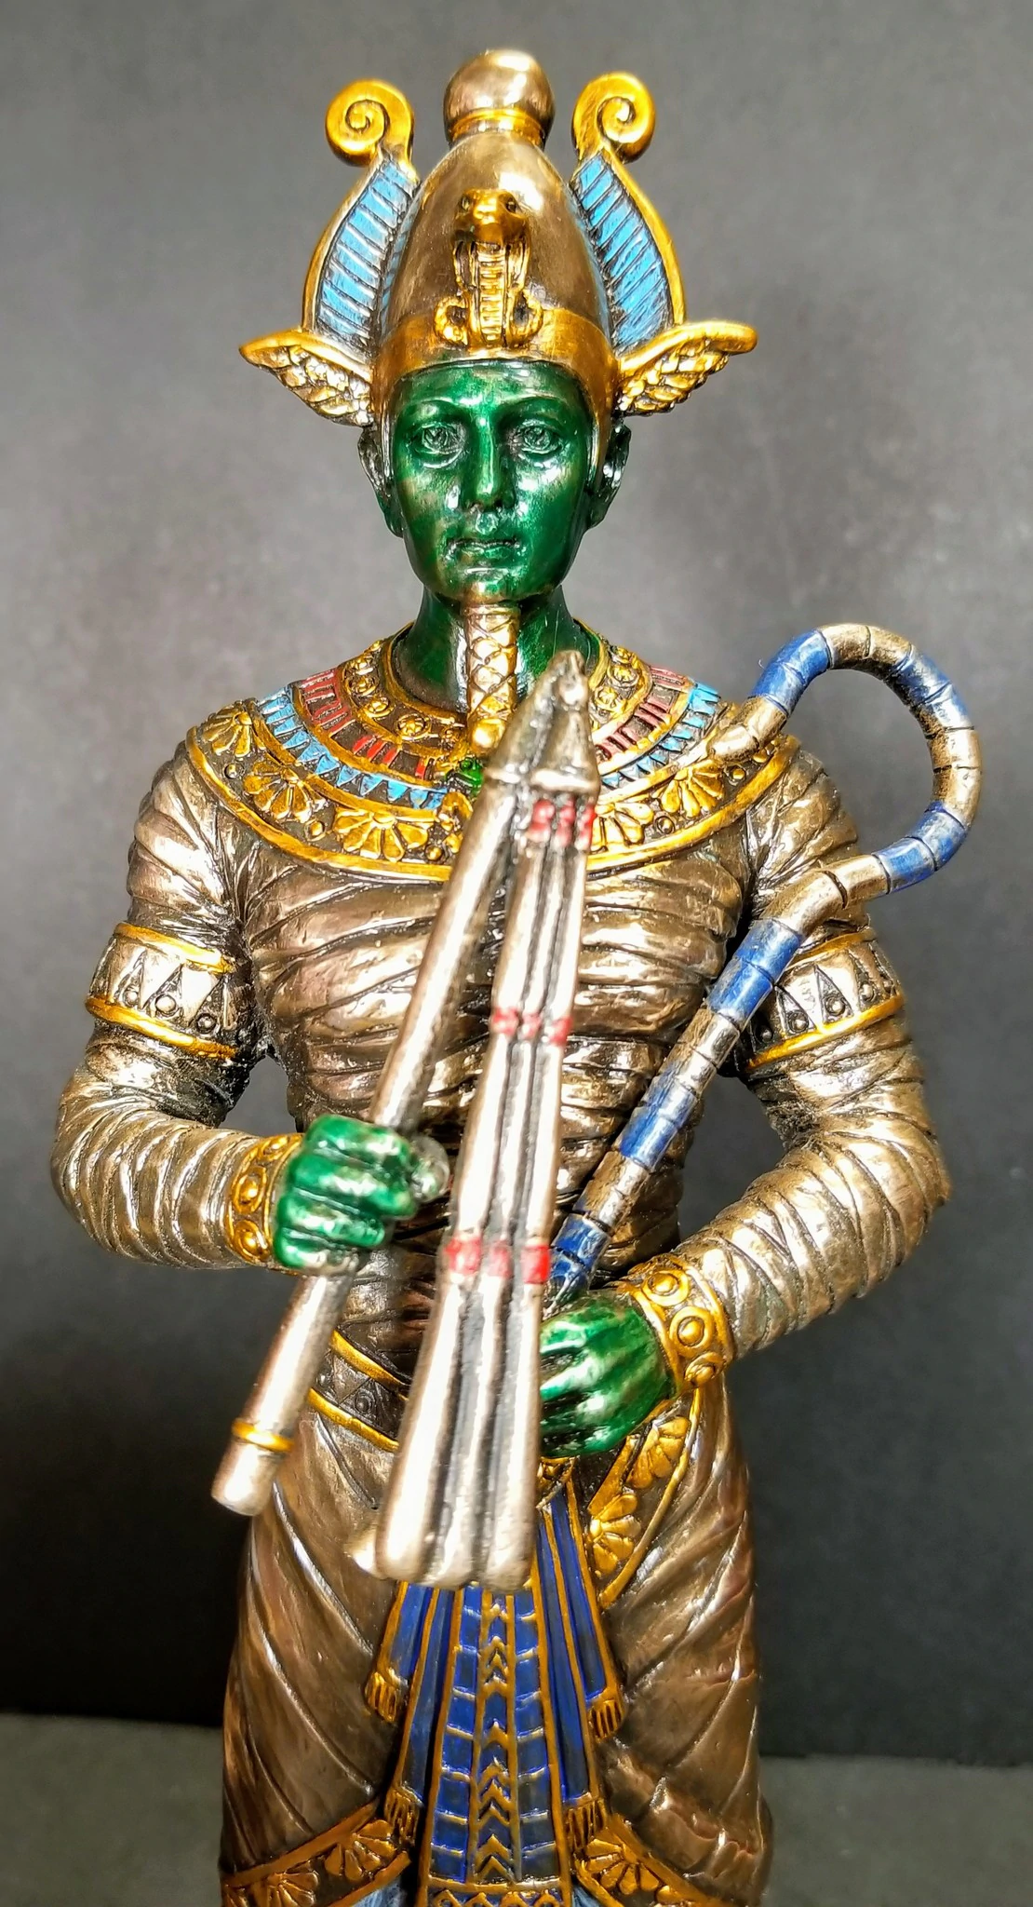
Osiris
Religion

Slide 8
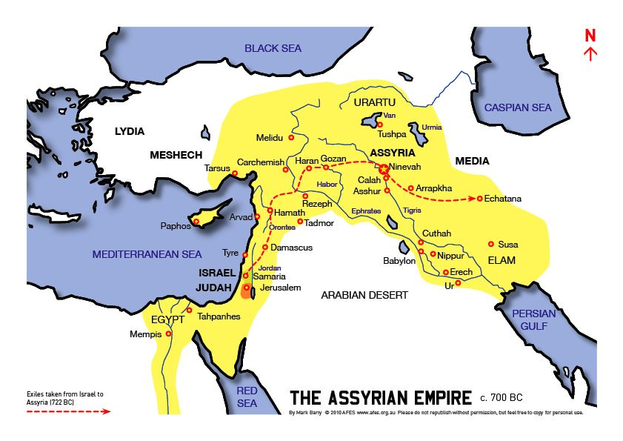
Assyrian

Slide 9
Ezekiel 31
Taller than –Imperialism
Watered – sources of income
Deep state control
Reach of Influence
Problem is Pride

Slide 10
Other notes
Little mercy 2 Kings 19: 17 – 18
God uses them to bring his people to their knees – Isaiah 8,9.
Defeat Israel (North) 2 Kings 18: 9 – 12
Defeat Judah (South) 2 Kings 18: 13

Slide 11
I Kings 18 – Jezebel and Elijah
V 17 Who is the problem
V 21 National Decision
V 30 Stop worship
V 37 Turn our hearts
19: 1 – 3 Intolerant.

