Slide 1
New World Order
Empire 2 – Assyria

Slide 2
Revelation 17
Religion
Politics
Economic

Slide 3
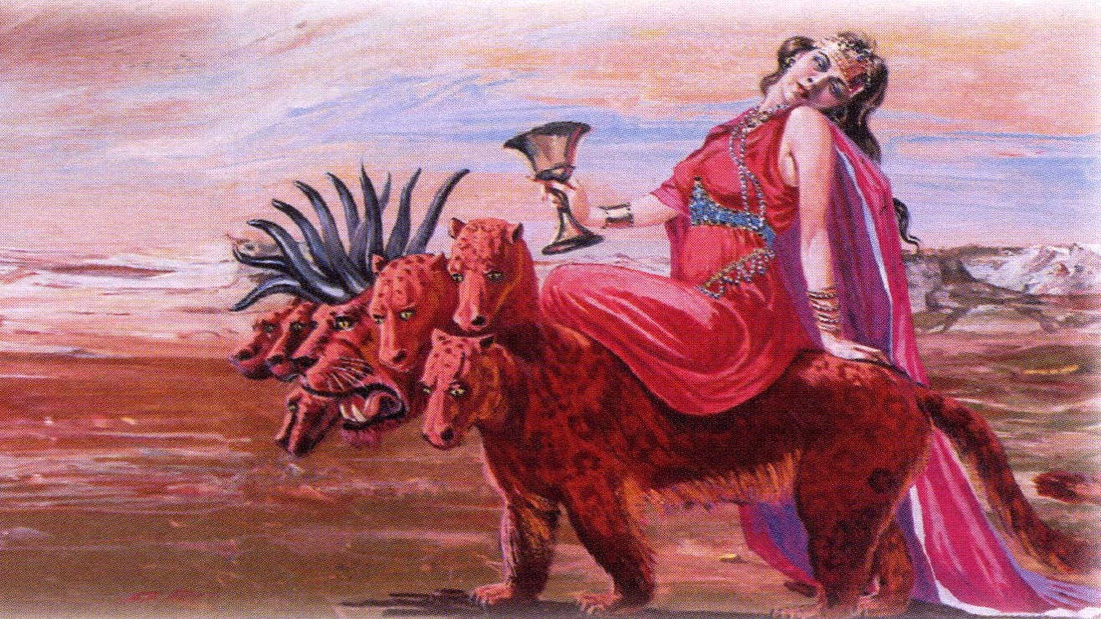

Slide 4
Woman chp 17:1 – 7 Religious | Beast – 17:9 – 11 Political | City – Rev. 18:9-17
Whore | Five fallen v 10 | Kings v9
Kings have fornicated | One is now v 10 | Merchants v 11, 15
Abominations | One is to come v 10 | Merchandise v 12
Mystery Babylon | 10 Kings to come v 12 | Fruit v 14
Mother of Harlots | One mind v 13 | Trade v 17

Slide 5
¹⁰ And there are seven kings: five are fallen, and one is, and the other is not yet come; and when he cometh, he must continue a short space.
Mede/
Persia
Greece
Roman
Egypt
Assyria
Babylon

Slide 6
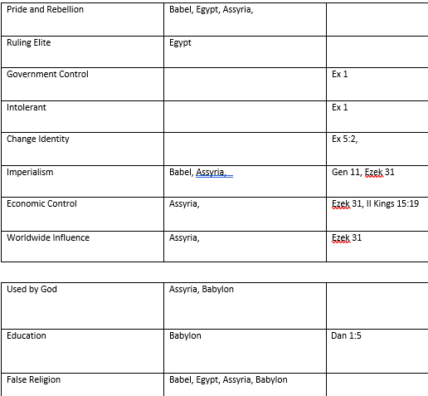

Slide 7
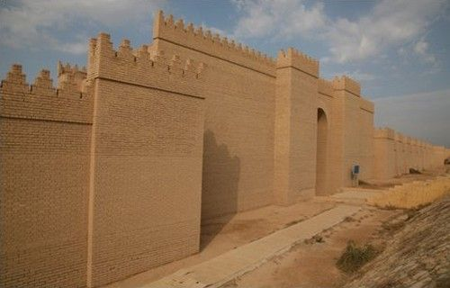
Ruins located in present day Iraq
Defeated Assyrians in 612 B.C.
Walls 14 miles long each side
56 miles around (196 sq Miles)
108 feet thick, 417 feet high
100 brazen Gates
3-4 story houses
Cross Streets and blocks

Slide 8
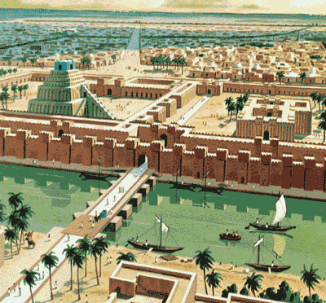
Built on both sides of the Euphrates
East and West joined by a bridge
Bride was 3,240 feet long.
Royal palace on each side of the bridge

Slide 9

Hanging Gardens 400 feet sq
Planted in terraces up the city
Temple to Bel Worship

Slide 10
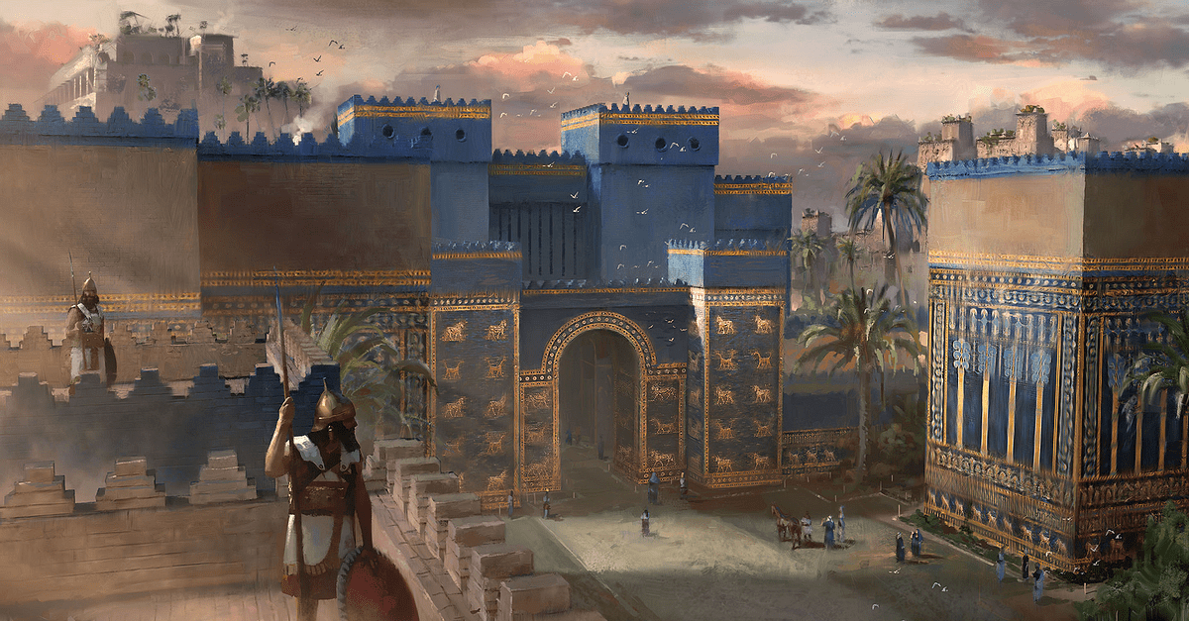
Gate of Ishtar

Slide 11
Control | Daniel 1:4
Education | Daniel 1:5
Food (Kings Meat) Identity | Daniel 1:5 Daniel 1:7
Imperial Worship (False religion) | Daniel 3:2
Obedience – Control | Daniel 3:6
Intolerant | Daniel 3:11

Slide 12
Daniel | Hannaniah | Mishael | Azariah
God is my Judge | God is gracious | Is what God is | God has helped
Beltshazzar | Shadrack | Meshach | Abednego
Bel (Baal) Babylon | Marduk (Mesop) | Aku (Assyrian) | Nebo (Chaldean)

Slide 13
Control | Daniel 1:4
Education | Daniel 1:5
Food (Kings Meat) Identity | Daniel 1:5 Daniel 1:7
Imperial Worship (False religion) | Daniel 3:2
Obedience – Control | Daniel 3:6
Intolerant | Daniel 3:11

Slide 14
“Do not Bend in convictions, do not Bow in compromise, and you will not Burn!”

