Slide 1
What in the World
When the Fire Falls
I Kings 18

Slide 2
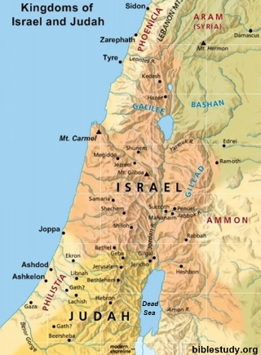
Background –
906 B.C.
Division
Cultural Pressures
Idol Worship
Corruption
Economic fall

Slide 3
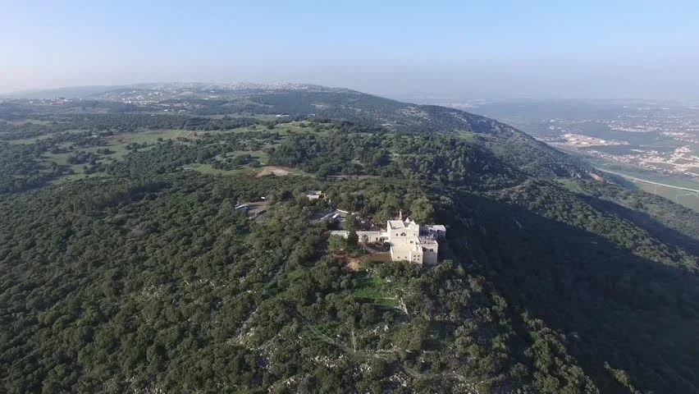
The Battle of God and Baal

Slide 4
Elements: Gathering in Unity
³⁰ And Elijah said unto all the people, Come near unto me. And all the people came near unto him. And he repaired the altar of the Lord that was broken down.
³¹ And Elijah took twelve stones, according to the number of the tribes of the sons of Jacob, unto whom the word of the Lord came, saying, Israel shall be thy name:

Slide 5
Elements: Separation
³² And with the stones he built an altar in the name of the Lord: and he made a trench about the altar, as great as would contain two measures of seed.

Slide 6
Elements: Gospel
³³ And he put the wood in order, and cut the bullock in pieces, and laid him on the wood, and said, Fill four barrels with water, and pour it on the burnt sacrifice, and on the wood.

Slide 7
Elements: Word
³³ And he put the wood in order, and cut the bullock in pieces, and laid him on the wood, and said, Fill four barrels with water, and pour it on the burnt sacrifice, and on the wood.
³⁴ And he said, Do it the second time. And they did it the second time. And he said, Do it the third time. And they did it the third time.
³⁵ And the water ran round about the altar; and he filled the trench also with water.

Slide 8
Elements: Prayer
³⁷ Hear me, O Lord, hear me, that this people may know that thou art the Lord God, and that thou hast turned their heart back again.

Slide 9
Elements: Fire (Holy Spirit)
³⁸ Then the fire of the Lord fell, and consumed the burnt sacrifice, and the wood, and the stones, and the dust, and licked up the water that was in the trench.
³⁹ And when all the people saw it, they fell on their faces: and they said, The Lord, he is the God; the Lord, he is the God.

Slide 10
Consumes
³⁸ Then the fire of the Lord fell, and consumed the burnt sacrifice, and the wood, and the stones, and the dust, and licked up the water that was in the trench.

Slide 11
Conviction
³⁹ And when all the people saw it, they fell on their faces: and they said, The Lord, he is the God; the Lord, he is the God.

Slide 12
Conversion
³⁹ And when all the people saw it, they fell on their faces: and they said, The Lord, he is the God; the Lord, he is the God.

