Slide 1
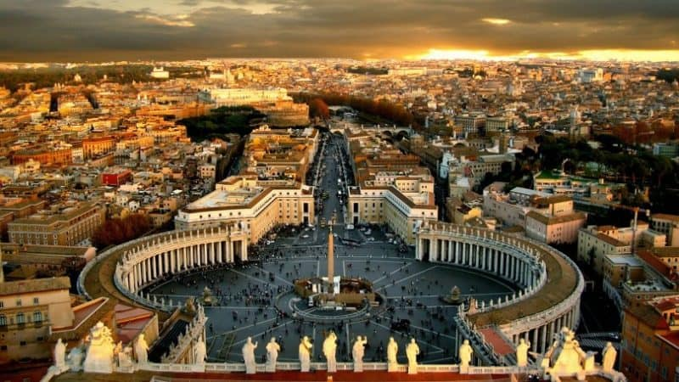
One World Religion Part 2

Slide 2
Many Waters – Population
17 And there came one of the seven angels which had the seven vials, and talked with me, saying unto me, Come hither; I will shew unto thee the judgment of the great whore that sitteth upon many waters:

Slide 3
False Doctrine
² With whom the kings of the earth have committed fornication, and the inhabitants of the earth have been made drunk with the wine of her fornication

Slide 4
Blasphemy
³ So he carried me away in the spirit into the wilderness: and I saw a woman sit upon a scarlet coloured beast, full of names of blasphemy, having seven heads and ten horns.

Slide 5
Wealthy
⁴ And the woman was arrayed in purple and scarlet colour, and decked with gold and precious stones and pearls, having a golden cup in her hand full of abominations and filthiness of her fornication:

Slide 6
Ancient Babylonian Cult
⁵ And upon her forehead was a name written, Mystery, Babylon The Great, The Mother Of Harlots And Abominations Of The Earth.
Daniel 4:7

Slide 7
Blood of saints and Martyrs
⁶ And I saw the woman drunken with the blood of the saints, and with the blood of the martyrs of Jesus: and when I saw her, I wondered with great admiration.

Slide 8
Has a City
¹⁸ And the woman which thou sawest is that great city, which reigneth over the kings of the earth

Slide 9
Ancient Babylonian Cult
⁵ And upon her forehead was a name written, Mystery, Babylon The Great, The Mother Of Harlots And Abominations Of The Earth.
Connection to Roman Catholic Church -133 B.C. Attalus Pontiff of the Babylonian Brotherhood died an gave the headship to Rome.
Julius Caesar made Pontiff as civil leader in 74 and made supreme Pontiff in 74 B.C.

Slide 10
313 A.D.
Constantine made this the official state religion.
This would begin the merging of paganism with Christianity.
He declared himself the Vicar of Christ.
He elevate converts to positions of influence and authority in his empire.
They brought in their traditions and mixed them with Christianity.

Slide 11
Many Waters – Population
17 And there came one of the seven angels which had the seven vials, and talked with me, saying unto me, Come hither; I will shew unto thee the judgment of the great whore that sitteth upon many waters:
Largest in the world with 1.1 million (1 in every 6)

Slide 12
False Doctrine
² With whom the kings of the earth have committed fornication, and the inhabitants of the earth have been made drunk with the wine of her fornication

Slide 13
Martin Luther 95 “Theses” Wittenberg, Germany 1500’s.

Slide 14
Scripture and Tradition – Sola Scriptura
Include the Apocrypha (Revelation 22:19)
“Both Scripture and Tradition must be accepted and honored with equal sentiments of devotion and reverence.”
Papal Infallibility – When speaking in his role as Vicar of Christ (his physical replacement).
2 Peter 1:21, 2 Timothy 3:16

Slide 15
Here are the Catholic Ten Commandments:
I am the LORD your God. You shall worship the Lord your God and Him only shall you serve.
You shall not take the name of the Lord your God in vain.
Remember to keep holy the Sabbath day.
Honor your father and your mother.
You shall not kill.
You shall not commit adultery.
You shall not steal.
You shall not bear false witness against your neighbor.
You shall not covet your neighbor’s wife.
You shall not covet your neighbor’s goods

Slide 16
Grace and Faith Alone- Salvation
Baptism – Sprinkling – This is a new birth.
This begins the process of Salvation.
We believe: “Believers Baptism” – Acts 2: 36 - 38
This is done after we are born again – John 3:3

Slide 17
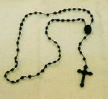
Penance – Act of repentance, required to receive forgiveness of sins after baptism.
Rosary – Set of prayers. String of Knots used to count the prayers.
Reading Scripture
Prayers – Our father or Hail Mary
Doing good works
Fasting

Slide 18
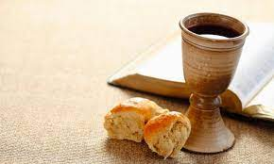
Transubstantiation
According to Compendium of the Catechism of the Catholic Church "The Eucharist is the very sacrifice of the Body and Blood of the Lord Jesus which he instituted to perpetuate the sacrifice of the cross throughout the ages until his return in glory.
John 6:53,54,63
His work was completed.
John 19:30

Slide 19
Mediation
Mary –
“Conceived immaculate” – No original sin. Never sinned. Free from wages of death (Never died).
Queen of Heaven – Jeremiah 44:17
Advocate to be prayed to
Prayers to Saints – elevated status (Romans 1:7)

Slide 20
Verse 3 Blasphemy – Make one God, Forgive sins.
Pope – Vicar of Christ – forgives sins as the representative of Christ.
Papal infallibility –
Hebrews 7:24-25
I Timothy 2:5
Acts 4:12

Slide 21
We believe in Faith alone by grace alone in Christ alone.
Ephesians 2:8-9
Titus 3:5
Romans 11:6

Slide 22
Heaven and Hell
Purgatory – “Purge” – Holding place- Intermediate stages.
Others can help them with restitutions by taking the Eucharistic sacrifice for them, almsgiving, indulgences, and works of penance.
Hebrews 9:27
Psalms 49:7-8

Slide 23
Blood of saints and Martyrs
⁶ And I saw the woman drunken with the blood of the saints, and with the blood of the martyrs of Jesus: and when I saw her, I wondered with great admiration.
Two major periods: Crusades (1-9 million people) and the Reformation.

Slide 24
Wealthy
⁴ And the woman was arrayed in purple and scarlet colour, and decked with gold and precious stones and pearls, having a golden cup in her hand full of abominations and filthiness of her fornication:
Knights Templar – Banking, Loans, Deals, and Western Union. 1100 A.D.

Slide 25
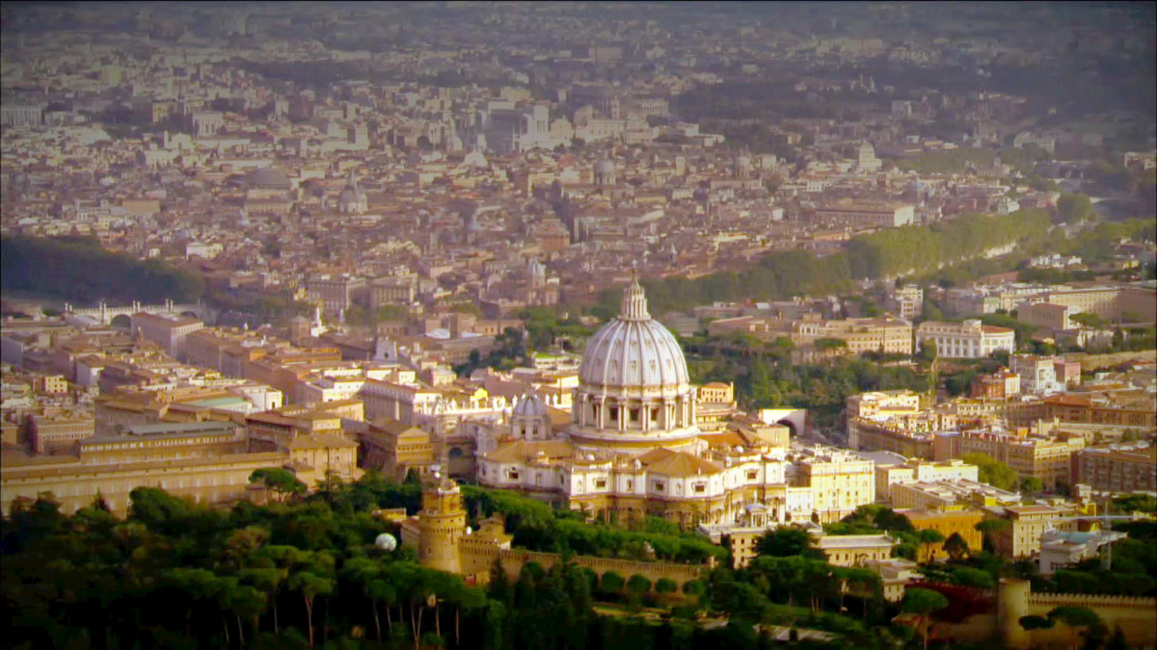
Has a City
¹⁸ And the woman which thou sawest is that great city, which reigneth over the kings of the earth
Feb 11, 1929

