Slide 1
Matthew 27 Genesis 22

Slide 2
Substitution
Cu(SO₄) + Fe Fe(SO₄) + Cu

Slide 3
Matthew 27 ¹⁵ Now at that feast the governor was wont to release unto the people a prisoner, whom they would.
¹⁶ And they had then a notable prisoner, called Barabbas.

Slide 4
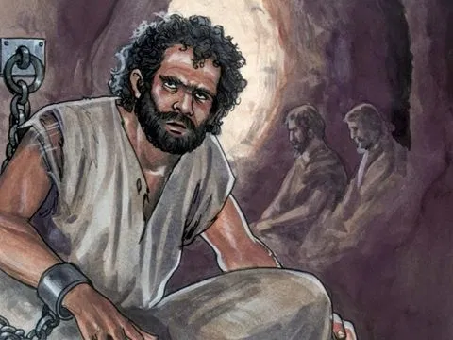
Mr. Guilty - Barabbas
John 18:40
“Highway Bandit”
Luke 23:19
“Insurrection”
“Murderer”

Slide 5
I. Choice
¹⁷ Therefore when they were gathered together, Pilate said unto them, Whom will ye that I release unto you? Barabbas, or Jesus which is called Christ?
¹⁸ For he knew that for envy they had delivered him.

Slide 6
It was an Emotional Choice
²⁰ But the chief priests and elders persuaded the multitude that they should ask Barabbas, and destroy Jesus.

Slide 7
It was a Casual Choice
²¹ The governor answered and said unto them, Whether of the twain will ye that I release unto you? They said, Barabbas.

Slide 8
It was an Irrational Choice
²² Pilate saith unto them, What shall I do then with Jesus which is called Christ? They all say unto him, Let him be crucified.
²³ And the governor said, Why, what evil hath he done? But they cried out the more, saying, Let him be crucified.

Slide 9
²⁴ When Pilate saw that he could prevail nothing, but that rather a tumult was made, he took water, and washed his hands before the multitude, saying, I am innocent of the blood of this just person: see ye to it.

Slide 10
It was a Fatal Choice
²⁵ Then answered all the people, and said, His blood be on us, and on our children.
“Choices Carve out our Destiny.”

Slide 11
We are the Crowd – It is our Choice
²² Pilate saith unto them, What shall I do then with Jesus which is called Christ?

Slide 12
II. Substitution
²⁶ Then released he Barabbas unto them: and when he had scourged Jesus, he delivered him to be crucified.

Slide 13
II. Substitution
“The Suffering of Christ, under the wrath of God, in our place.”
^{I Peter2:24} Who his own self bare our sins in his own body on the tree, that we, being dead to sins, should live unto righteousness: by whose stripes ye were healed

Slide 14
Illustration: The Call of Faith
Genesis 22 ² And he said, Take now thy son, thine only son Isaac, whom thou lovest, and get thee into the land of Moriah; and offer him there for a burnt offering upon one of the mountains which I will tell thee of.³ And Abraham rose up early in the morning,
“What am I doing with Gods Calling?”

Slide 15
The Price and The Love
⁹ And they came to the place which God had told him of; and Abraham built an altar there, and laid the wood in order, and bound Isaac his son, and laid him on the altar upon the wood.
¹⁰ And Abraham stretched forth his hand, and took the knife to slay his son.

Slide 16
The Provision and The Substitute
¹³ And Abraham lifted up his eyes, and looked, and behold behind him a ram caught in a thicket by his horns: and Abraham went and took the ram, and offered him up for a burnt offering in the stead of his son.

